Slide 1
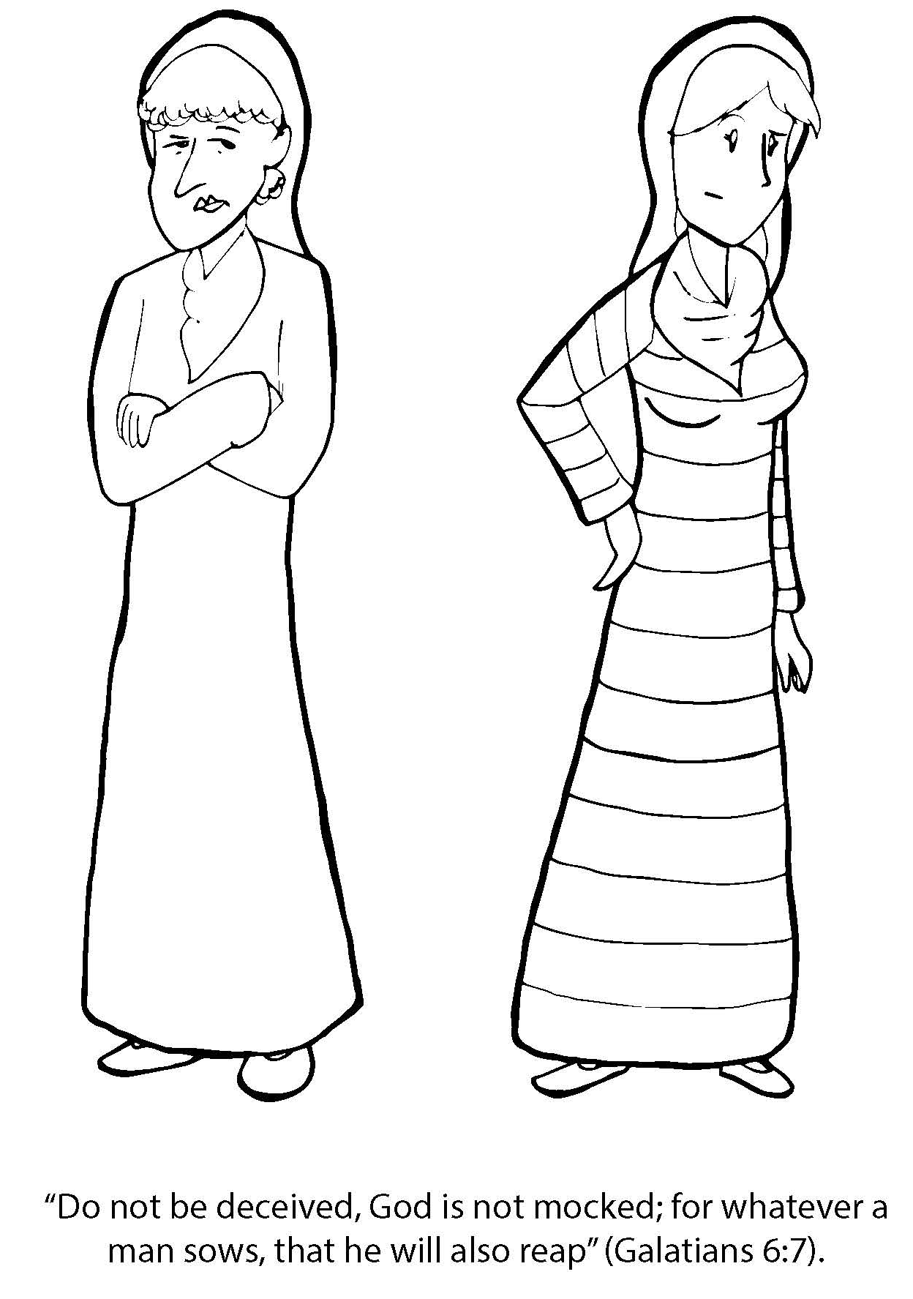
Booneville Church of Christ 4 Year Old Bible Class
Quarter 2, Lesson 1
Today’s Lesson | Leah and Rachel Genesis 29
Questions for Review | Who were Jacob’s wives? Leah and Rachel Who was his favorite? Rachel How long did Jacob have to work for Laban for his wife, Rachel? Fourteen years Does God want men to have two wives? No, God intended for one man to be married to one woman.
Memory Work | Books of the Bible Deuteronomy 6:5
Next Week’s Lesson | 12 Sons of Jacob/ Agreement of Jacob and Laban Genesis 29:1-30:24

Slide 2
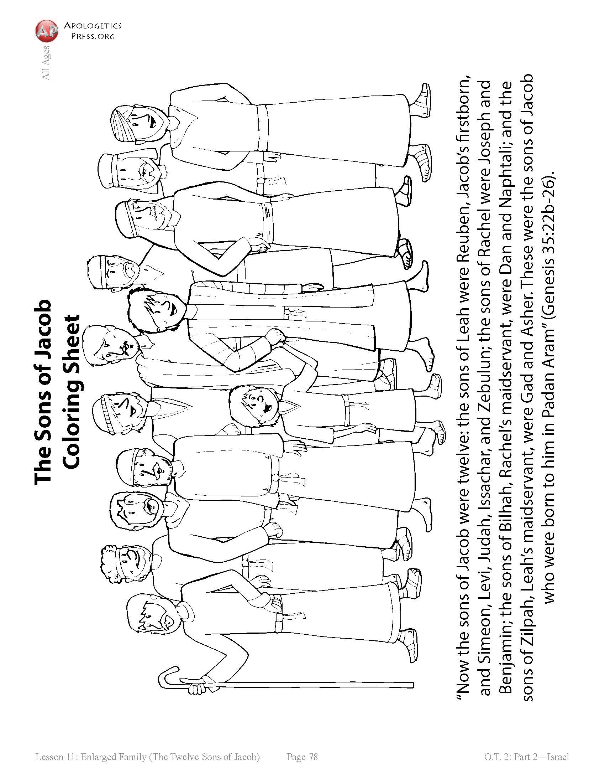
Booneville Church of Christ 4 Year Old Bible Class
Quarter 2, Lesson 2
Today’s Lesson | 12 Sons of Jacob/ Agreement of Jacob and Laban Genesis 29:1-30:24
Questions for Review | How many sons did Jacob have? 12 What nation came from Jacob’s family? The nation of Israel/ The Israelites Where did God tell Jacob to go? Canaan
Memory Work | Books of the Bible Deuteronomy 6:5
Next Week’s Lesson | Jacob and Esau Meet Again Genesis 32, 33

Slide 3
Booneville Church of Christ 4 Year Old Bible Class
Quarter 2, Lesson 3
Today’s Lesson | Jacob and Esau Meet Again Genesis 32, 33
Questions for Review | Did Jacob and Esau ever meet again after Jacob left his father’s house? Yes Who did Jacob ask for help and protection from his brother? God What did Esau do as a sign of respect and humility? He bowed to Esau Was Esau still mad at Jacob? No, he had forgiven him.
Memory Work | Books of the Bible Deuteronomy 6:5
Next Week’s Lesson | Joseph the Dreamer Genesis 35, 37

Slide 4
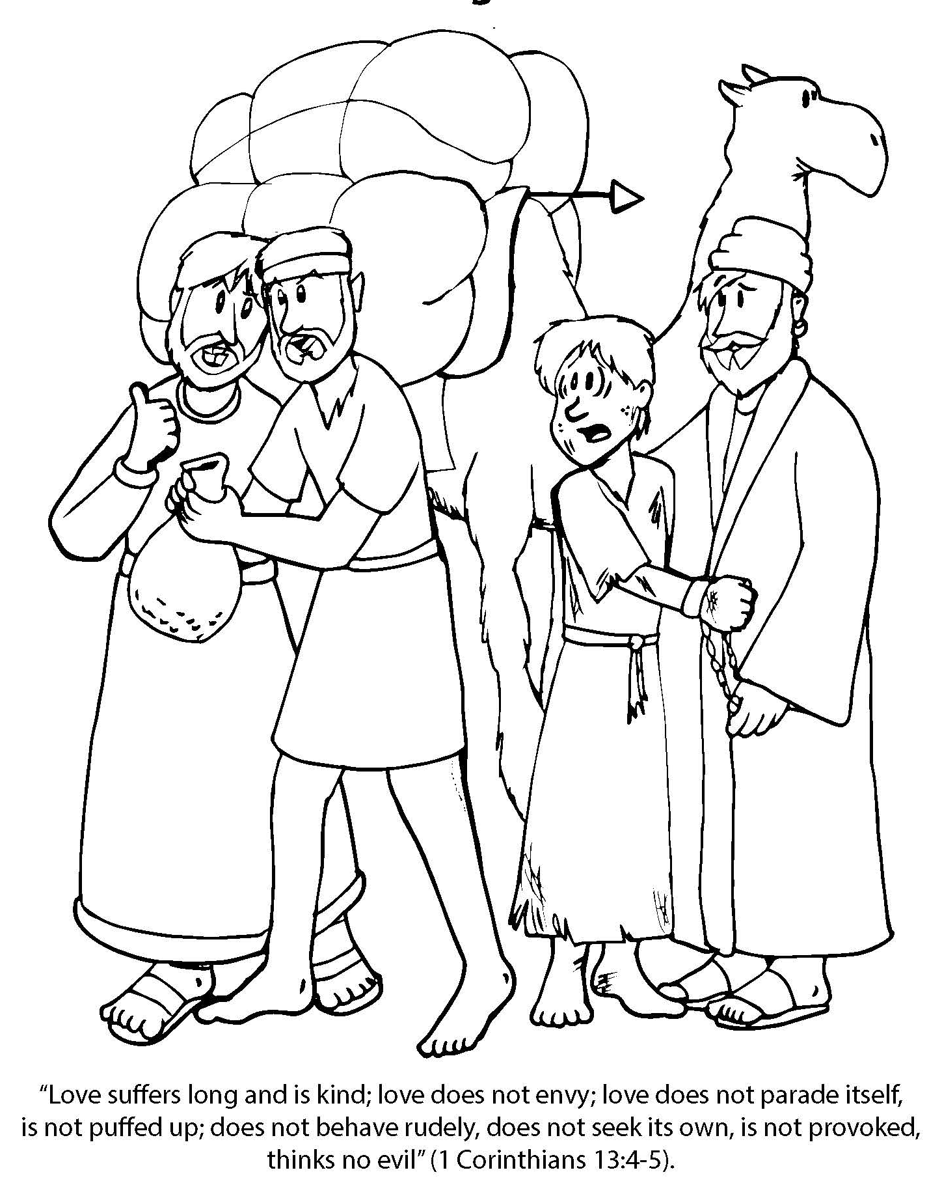
Booneville Church of Christ 4 Year Old Bible Class
Quarter 2, Lesson 4
Today’s Lesson | Joseph the Dreamer Genesis 35, 37
Questions for Review | Who was Jacob’s favorite son? Joseph What did Jacob give Joseph that was special? A coat of many colors What mean thing did the brothers do to Joseph? Put him in a pit then sold him. What did Jacob think happened to Joseph? A wild animal ate him.
Memory Work | Books of the Bible Deuteronomy 6:5
Next Week’s Lesson | Joseph in Egypt/ Baker & Butler Genesis 39-40

Slide 5
Booneville Church of Christ 4 Year Old Bible Class
Quarter 2, Lesson 5
Today’s Lesson | Joseph in Egypt/ Baker & Butler Genesis 39-40
Questions for Review | Where did the traders take Joseph? Egypt Who did Joseph work for? Potiphar Why did Joseph go to jail? Potiphar’s wife told a lie about him. Whose dreams did Joseph interpret? Pharaoh’s butler and baker. Which man was released from prison? The butler What did Joseph ask the butler to do? Remember him when he was released from prison
Memory Work | Books of the Bible Deuteronomy 6:5
Next Week’s Lesson | Pharaoh's Dream Genesis 41

Slide 6
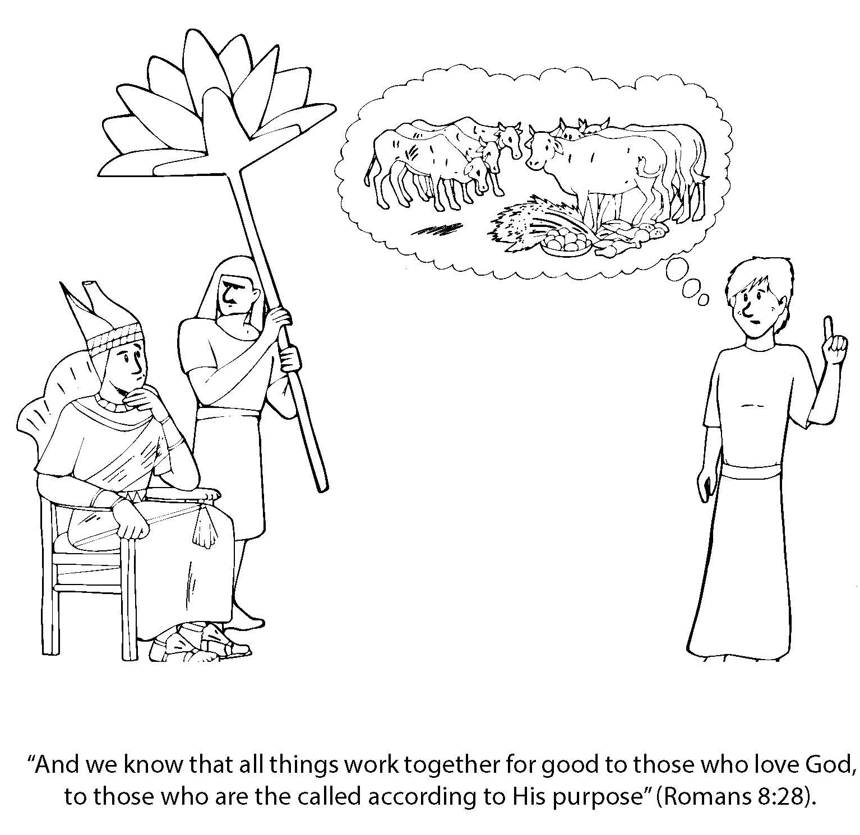
Booneville Church of Christ 4 Year Old Bible Class
Quarter 2, Lesson 6
Today’s Lesson | Pharaoh's Dream Genesis 41
Bible Words We Learned | Famine – A time of very little food, usually due to lack of rain.
Questions for Review | Did the butler mention Joseph to Pharaoh when he got out of jail? No, he did not remember Joseph until Pharaoh had strange dreams. Retell Pharaoh’s dreams. Seven skinny cows ate seven fat cows. Then seven thin ears of grain ate seven fat ears of grain. What did the dreams mean? There would be 7 years of plenty, then 7 years of famine. How did Pharaoh reward Joseph? He made him second in command in charge of preparing Egypt for famine. He also gave him a wife.
Memory Work | Books of the Bible Deuteronomy 6:5
Next Week’s Lesson | Joseph Prepares for Famine/Jacob’s Family Moves Genesis 41-50

Slide 7
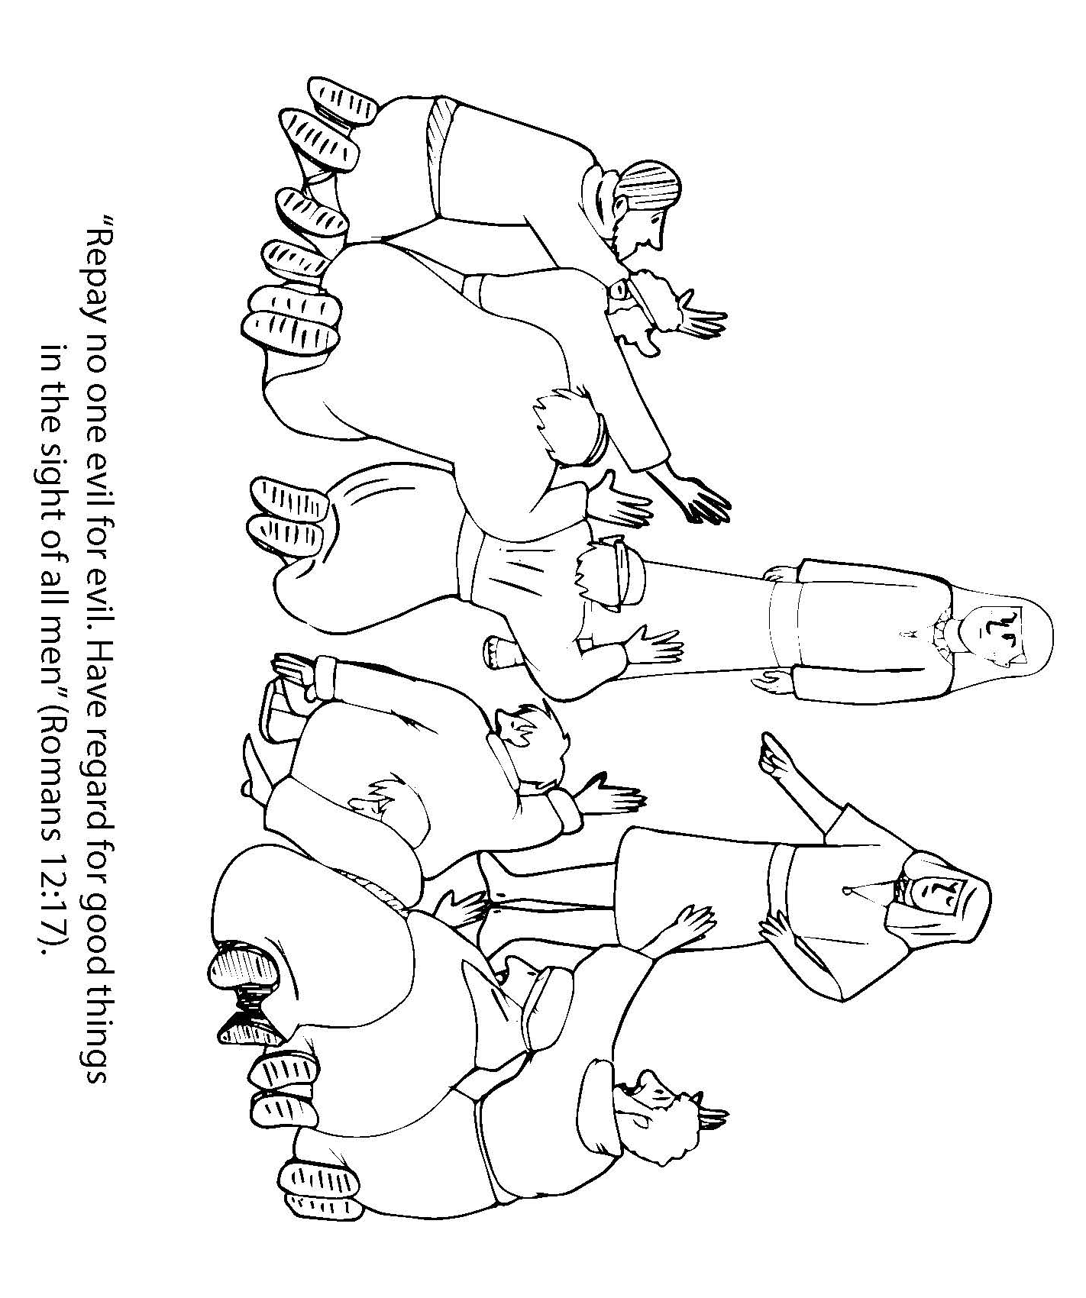
Booneville Church of Christ 4 Year Old Bible Class
Quarter 2, Lesson 7
Today’s Lesson | Joseph Prepares for Famine/Jacob’s Family Moves Genesis 41-50
Bible Words We Learned | Famine – a time of little food usually due to lack of rain
Questions for Review | How many years did Joseph spend gathering food and grain? 7 years Did the famine only affect Egypt? No, it spread to other countries. Why did Joseph’s brothers come to Egypt? To buy food Did Joseph punish his brothers for selling him? No, he forgave them.
Memory Work | Books of the Bible Deuteronomy 6:5
Next Week’s Lesson | Birth of Moses Exodus 1,2

Slide 8
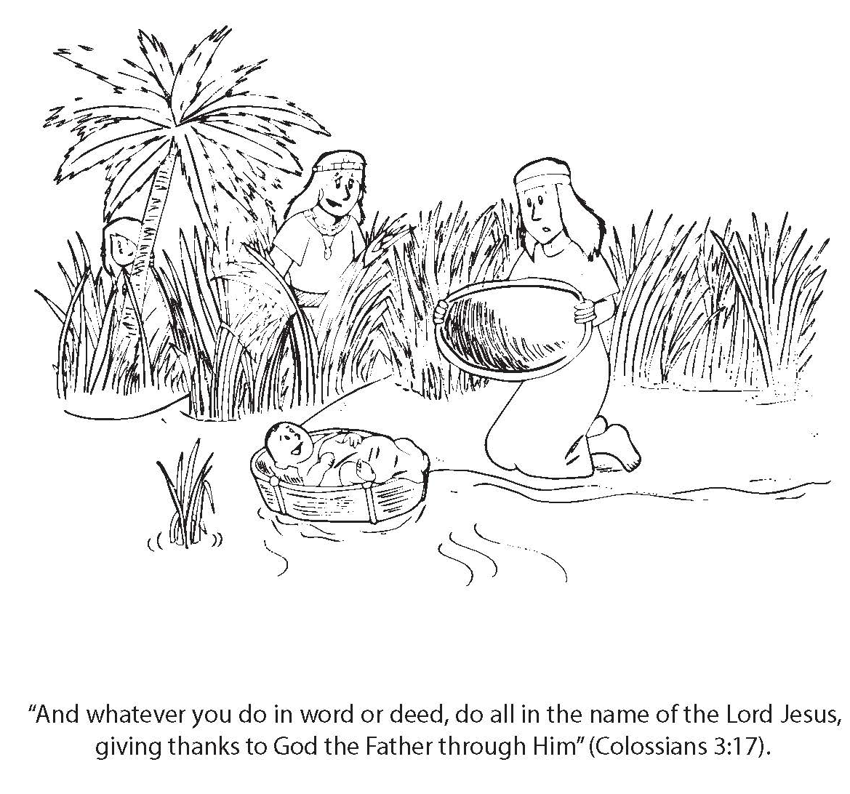
Booneville Church of Christ 4 Year Old Bible Class
Quarter 2, Lesson 8
Today’s Lesson | Birth of Moses Exodus 1,2
Bible Words We Learned | Midwife – a woman who delivered babies
Questions for Review | What did Pharaoh want done to the Hebrew boy babies? He wanted them to be killed. What was Moses hidden in? A basket placed in the Nile River? Who found Moses? Pharaoh’s daughter After he was older, where did Moses grow up? In Pharaoh’s palace, as the son of the princess.
Memory Work | Books of the Bible Deuteronomy 6:5
Next Week’s Lesson | Burning Bush Exodus 2:11- 4:23

Slide 9
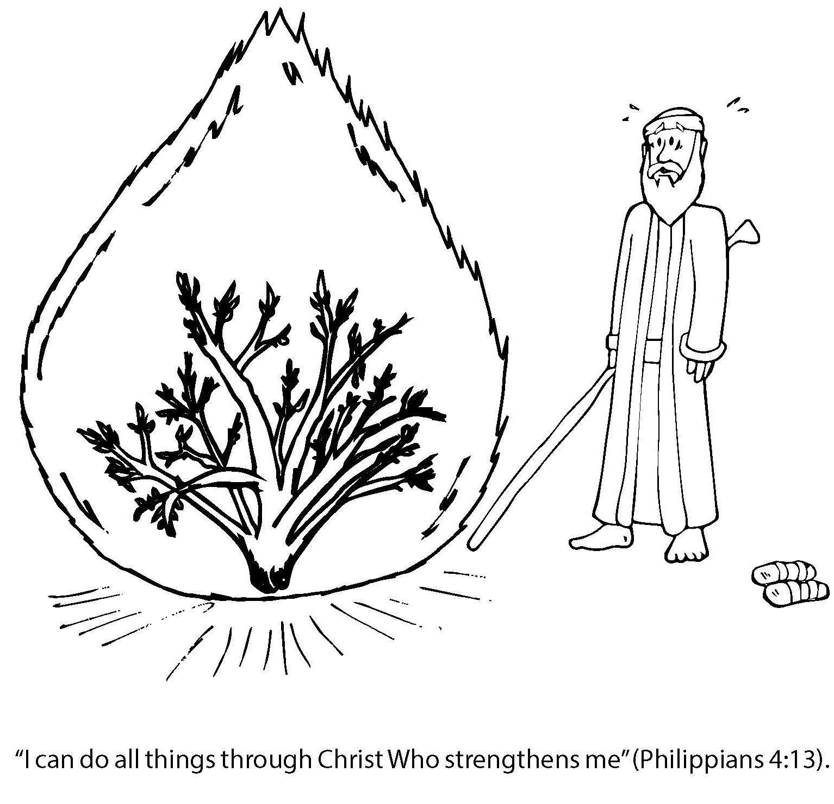
Booneville Church of Christ 4 Year Old Bible Class
Quarter 2, Lesson 9
Today’s Lesson | Burning Bush Exodus 2:11- 4:23
Questions for Review | Why did Moses leave Egypt? Pharaoh wanted to kill Moses because Moses killed an Egyptian who was mistreating a Hebrew. Where did Moses go? The desert of Midian What was Moses new job? A shepherd From what did God speak to Moses? A burning bush What did God want Moses to do? Go to Egypt and tell Pharaoh to let His people go.
Memory Work | Books of the Bible Deuteronomy 6:5
Next Week’s Lesson | Plagues 1-9 Exodus 4;27-11:10

Slide 10
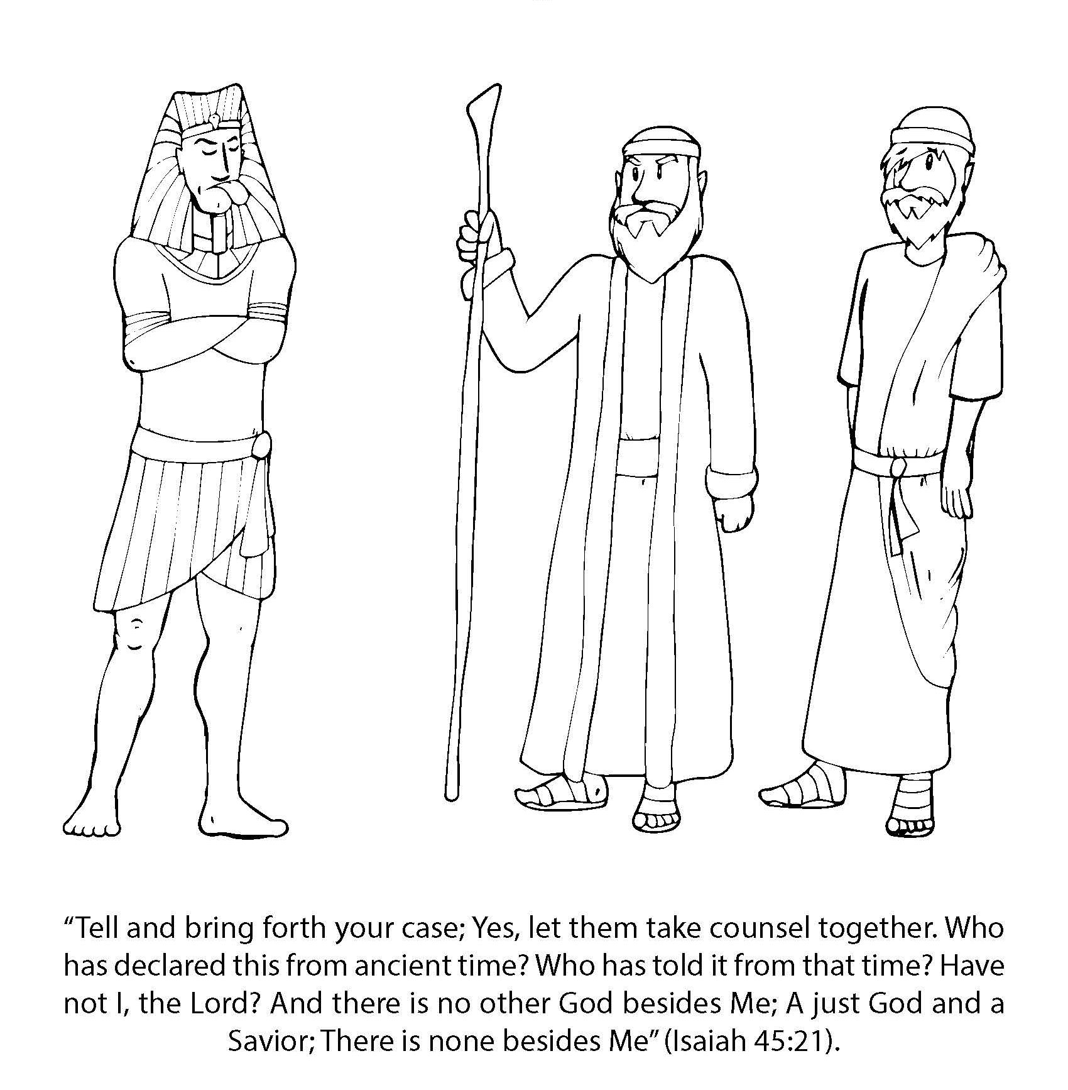
Booneville Church of Christ 4 Year Old Bible Class
Quarter 2, Lesson 10
Today’s Lesson | Plagues 1-9 Exodus 4:27-11:10
Bible Words We Learned | Boil – A red swollen sore on the skin
Questions for Review | Why did Pharaoh not listen to Moses and Aaron? He did not believe in the true God. Review Plagues 1-9 (1)Water to Blood (2) Frogs (3) Lice (4) Flies (5) Death of livestock (6) Boils (7) Hail (8) Locusts (9) Darkness Did Pharaoh let the people go after 9 plagues? No.
Memory Work | Books of the Bible Deuteronomy 6:5
Next Week’s Lesson | Passover and Exodus Exodus 11-15

Slide 11
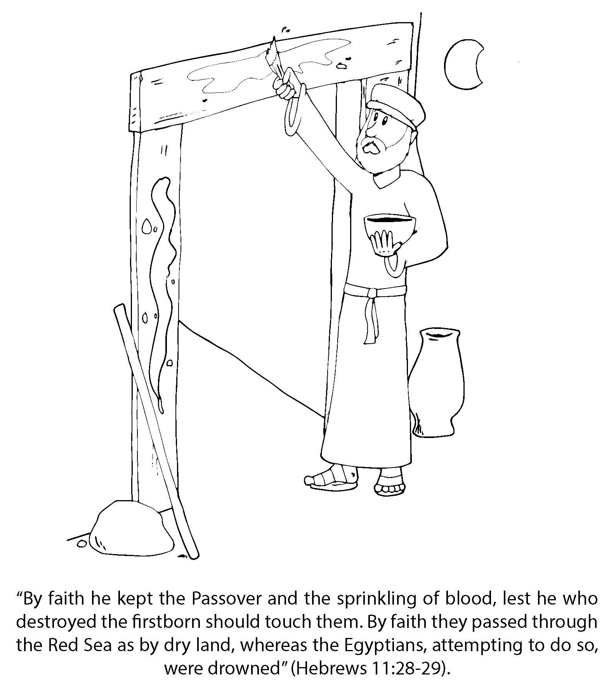
Booneville Church of Christ 4 Year Old Bible Class
Quarter 2, Lesson 11
Today’s Lesson | Passover and Exodus Exodus 11-15
Bible Words We Learned | Passover – The time God passed over the houses of all who obeyed him in Egypt.
Questions for Review | What was the tenth plague? The death of the firstborn Why did the firstborn of the Hebrews not die? They obeyed God by putting blood on the doorframe of their houses. Did Pharaoh finally let the Hebrews go? Yes What did Pharaoh do when he changed his mind? He sent the Egyptian army after the Israelites in the desert. How did God save the Israelites from Pharaoh’s army? He parted the Red Sea for the Israelites to cross. Then He made the waters come back over the army that followed them.
Memory Work | Books of the Bible Deuteronomy 6:5
Next Week’s Lesson | God Provides Food and Water Exodus 12:22-17:7

Slide 12
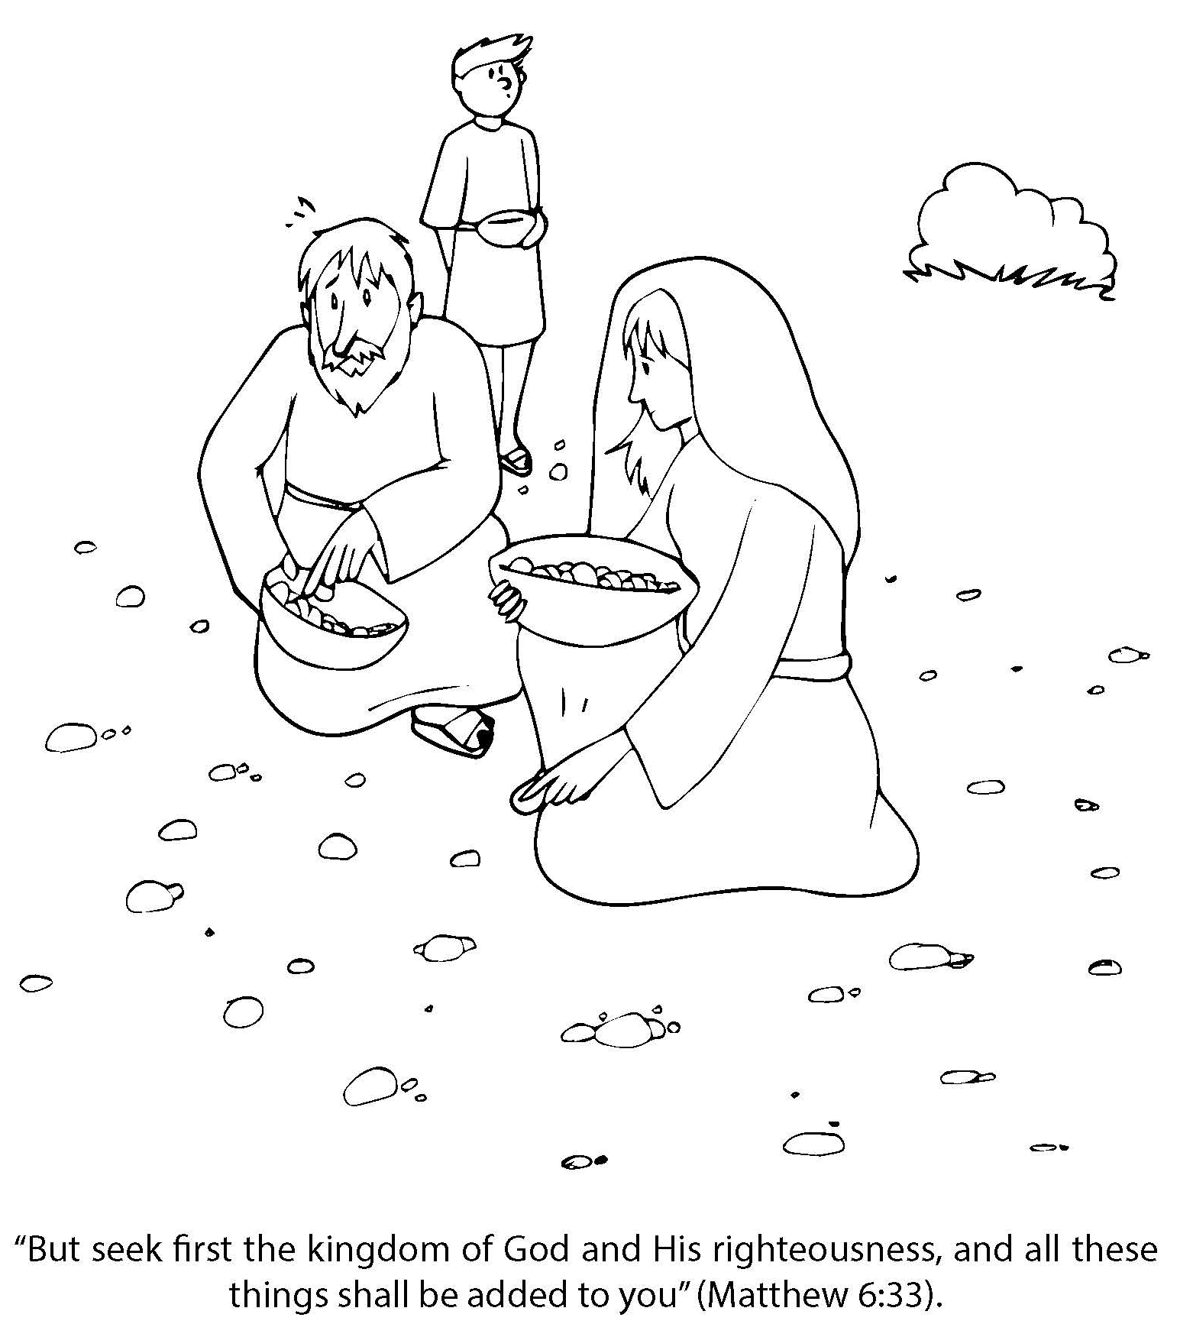
Booneville Church of Christ 4 Year Old Bible Class
Quarter 2, Lesson 12
Today’s Lesson | God Provides Food and Water Exodus 12:22-17:7
Questions for Review | What did God do when the Israelites complained about not enough food? He gave them food from heaven. They called it manna. What were God’s instructions about the manna? Gather only enough to eat for that day except on Friday, gather enough for two days since none would be sent on the Sabbath (Saturday). How did God miraculously give the Israelites water? Moses struck a rock and water came out of it.
Memory Work | Books of the Bible Deuteronomy 6:5
Next Week’s Lesson | 10 Commandments Exodus 19, 20, 24

Slide 13
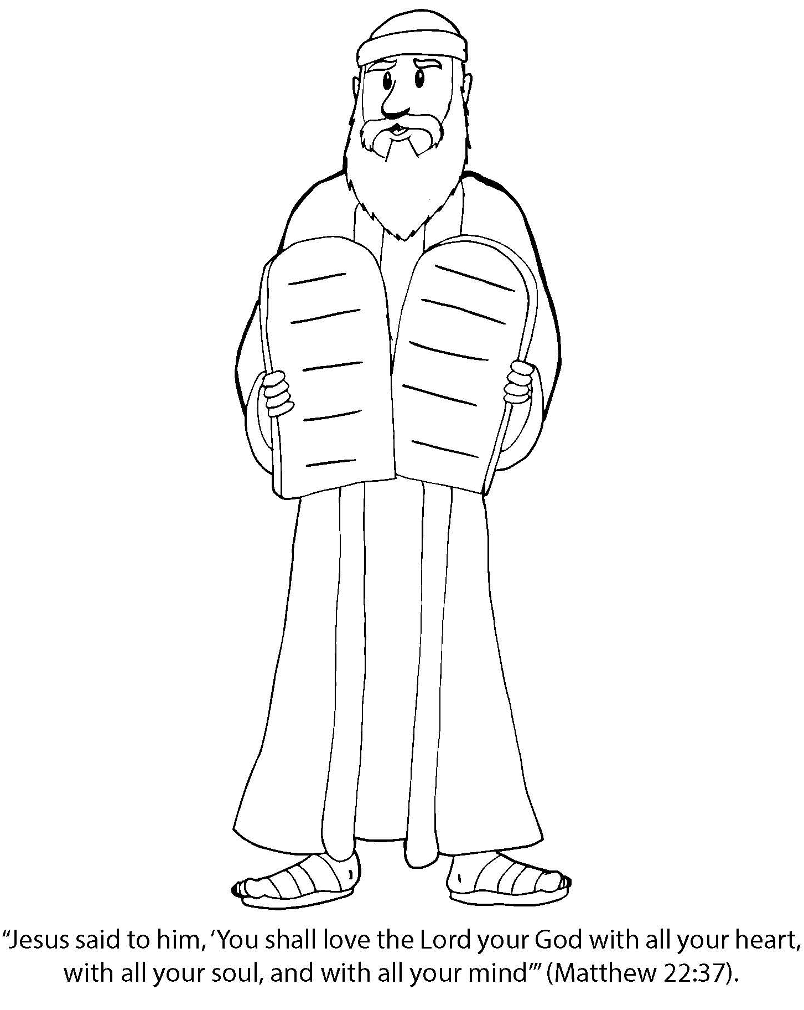
Booneville Church of Christ 4 Year Old Bible Class
Quarter 2, Lesson 13
Today’s Lesson | 10 Commandments Exodus 19, 20, 24
Bible Words We Learned | Vain – to use in a useless or disrespectful way
Questions for Review | On what mountain did Moses receive the commandments? Mt. Sinai Review the 10 commandments (1) Have no other gods. (2) Do not make idols. (3) Do not take God’s name in vain. (4) Remember the Sabbath (5) Honor your father and mother (6) Do not murder (7) Stay true to your spouse (8) Do not steal (9) Do not be a false witness (10) Do not covet.
Memory Work | Books of the Bible Deuteronomy 6:5
Next Week’s Lesson | The Golden Calf Exodus 20, 32

