Slide 1
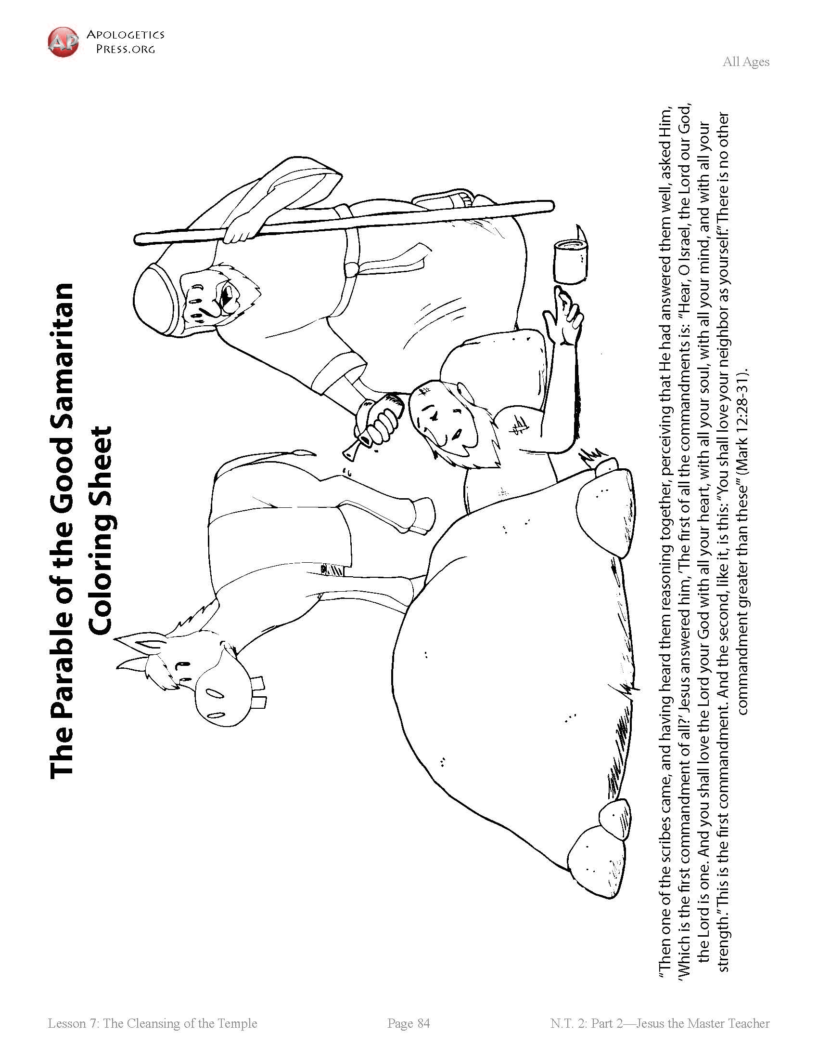
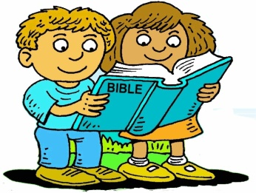
Booneville Church of Christ Kindergarten Bible Class
Quarter 3, Lesson 1
Today’s Lesson | The Good Samaritan Luke 10
Questions for Review | Who attacked the traveling man? Robbers What did the priest and Levite do when they saw the man on the side of the road? Kept on walking and didn’t help Who helped the man? A Samaritan
Bible Skills to Practice | An adult should look up the book of Luke. Ask the student to find chapter 10. Remind them the chapters are the larger numbers.
Memory Work | Luke 19:10 – for the Son of Man has come to seek and to save that which was lost. 12 Apostles Books of the Bible
Next Week’s Lesson | Jesus Heals a Man Born Blind John 9

Slide 2
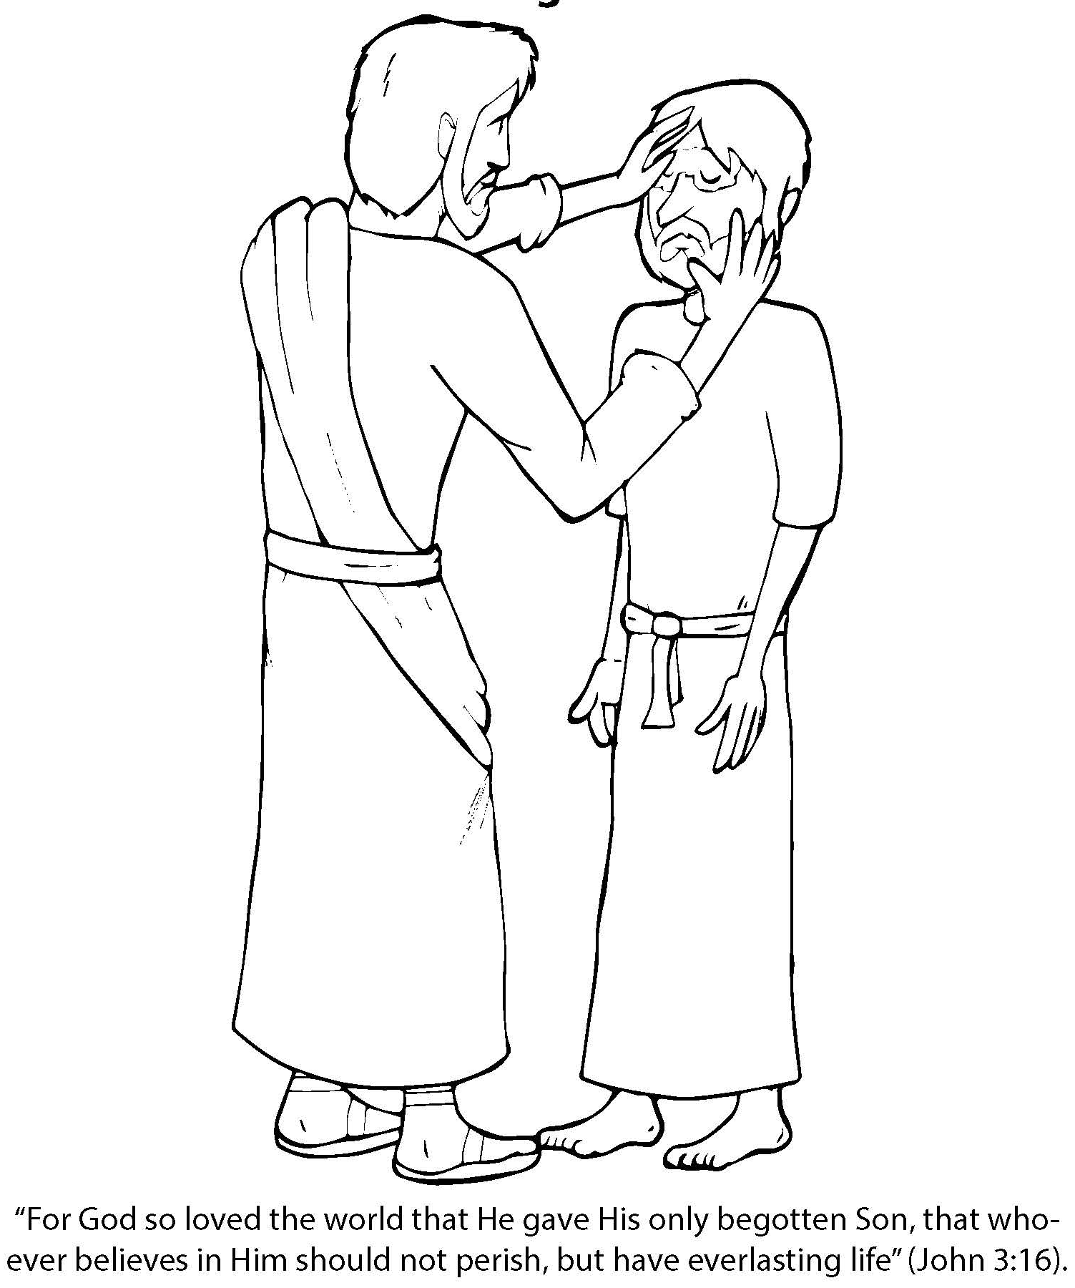
Booneville Church of Christ Kindergarten Bible Class
Quarter 3, Lesson 2
Today’s Lesson | Jesus Heals a Man Born Blind John 9
Questions for Review | What did Jesus put on the blind man’s eyes? Mud made out of dirt and spit What happened when the man washed the dirt off? He could see
Bible Skills to Practice | An adult should look up the book of John. Ask the student to find chapter 9. Remind them the chapters are the larger numbers.
Memory Work | Luke 19:10 – for the Son of Man has come to seek and to save that which was lost. 12 Apostles Books of the Bible
Next Week’s Lesson | The Good Shepherd and the Lost Sheep Luke 15

Slide 3
Booneville Church of Christ Kindergarten Bible Class
Quarter 3, Lesson 3
Today’s Lesson | The Good Shepherd and the Lost Sheep Luke 15
Questions for Review | Who is our good shepherd? Jesus How many sheep did the shepherd have? 100 How many were lost? 1 What did the shepherd do when the sheep was lost? He left the 99 sheep and looked for the 1 lost sheep.
Bible Skills to Practice | An adult should look up the book of Luke. Ask the student to find chapter 15. Remind them the chapters are the larger numbers.
Memory Work | Luke 19:10 – for the Son of Man has come to seek and to save that which was lost. 12 Apostles Books of the Bible
Next Week’s Lesson | The Prodigal Son Luke 15

Slide 4
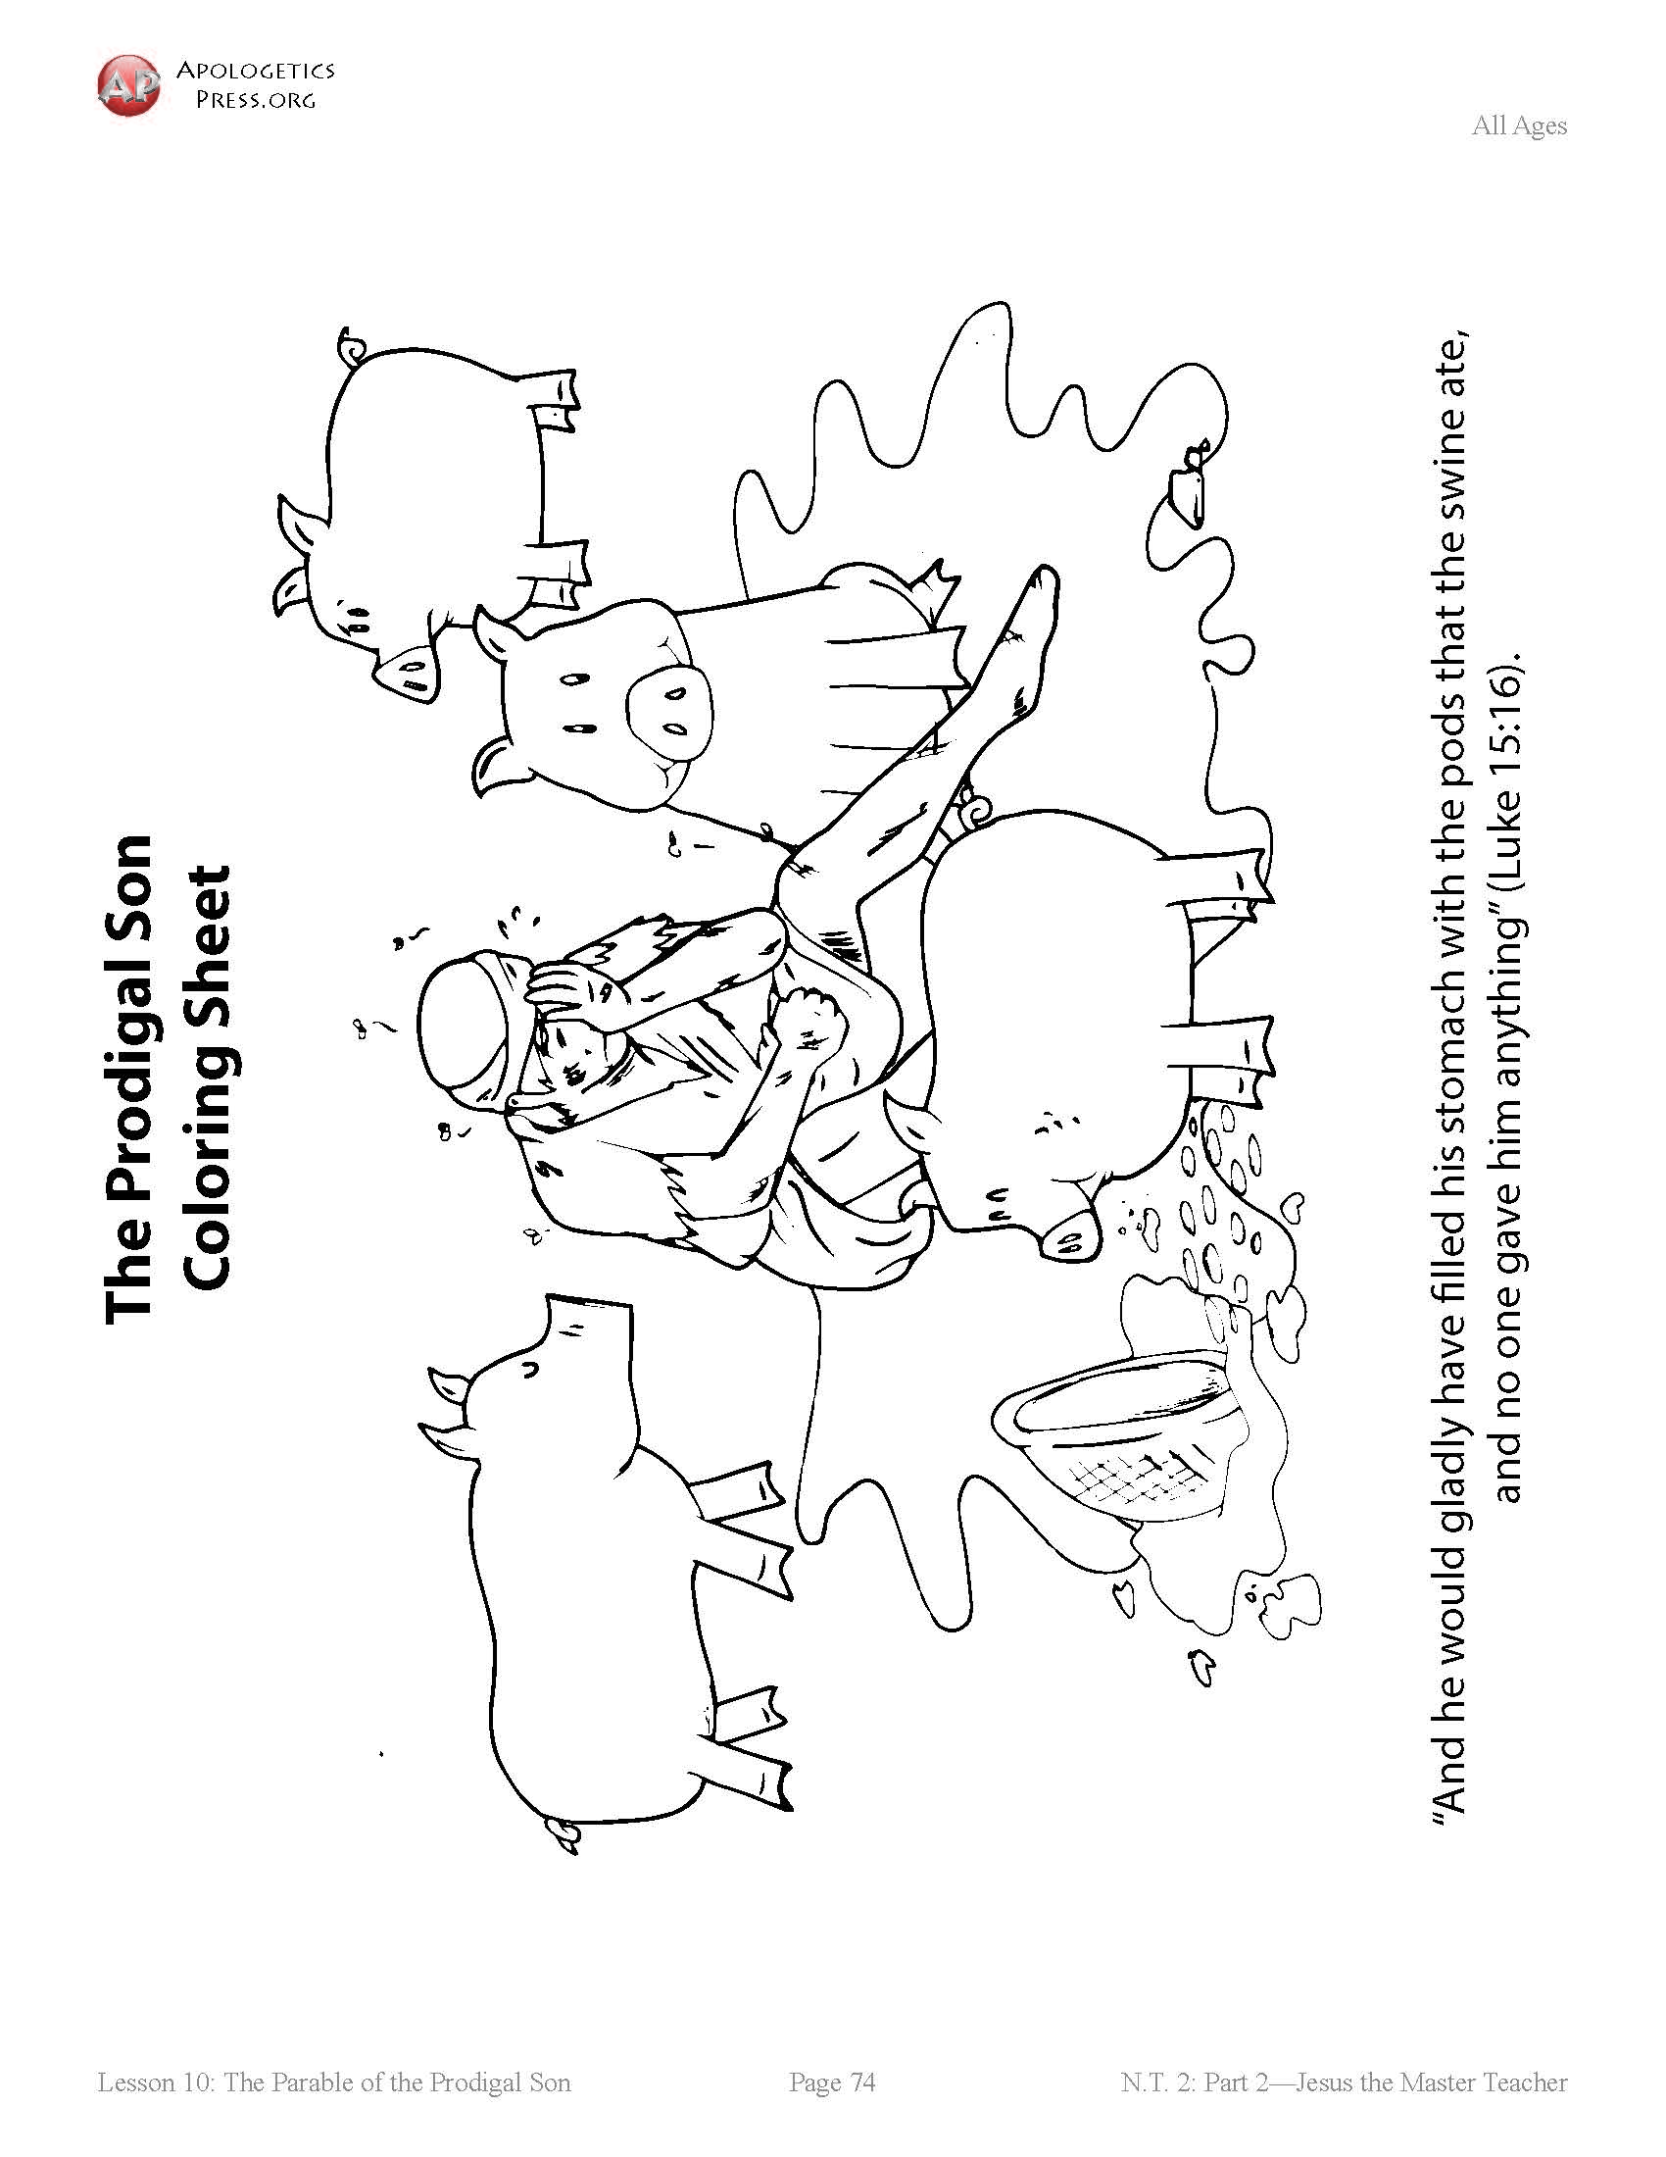
Booneville Church of Christ Kindergarten Bible Class
Quarter 3, Lesson 4
Today’s Lesson | The Prodigal Son Luke 15
Bible Words We Learned | Prodigal – wasteful
Questions for Review | Which son wanted his father’s money? The younger Did he make good choices in friends and spending his money? No. When the money was gone so were his “friends.” What did the father do when he saw him coming home? He hugged him, forgave him, and gave him a party to celebrate.
Bible Skills to Practice | An adult should look up the book of Luke. Ask the student to find chapter 15. Remind them the chapters are the larger numbers.
Memory Work | Luke 19:10 – for the Son of Man has come to seek and to save that which was lost. 12 Apostles Books of the Bible
Next Week’s Lesson | Jesus Heals Ten Lepers Luke 17

Slide 5
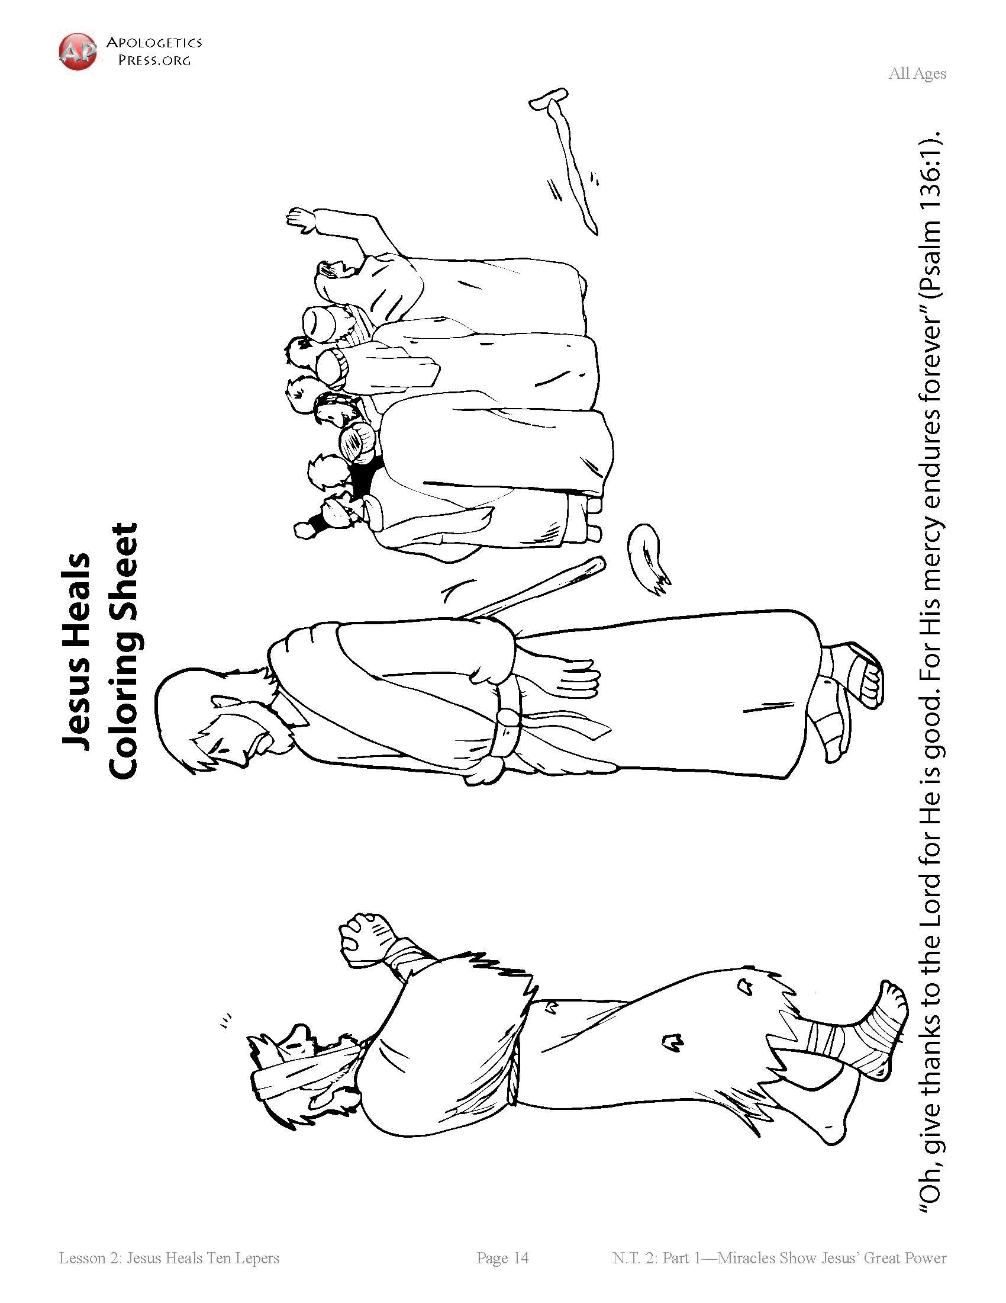
Booneville Church of Christ Kindergarten Bible Class
Quarter 3, Lesson 5
Today’s Lesson | Jesus Heals Ten Lepers Luke 17
Bible Words We Learned | Leper – A person with leprosy. Leprosy was a skin disease that could not be cured.
Questions for Review | What was wrong with the 10 men Jesus met? They had leprosy What did Jesus do for the men? He took away their leprosy. How many of the lepers said thank you? 1
Bible Skills to Practice | An adult should look up the book of Luke. Ask the student to find chapter 17. Remind them the chapters are the larger numbers.
Memory Work | Luke 19:10 – for the Son of Man has come to seek and to save that which was lost. 12 Apostles Books of the Bible
Next Week’s Lesson | Jesus Raises Lazarus John 11

Slide 6
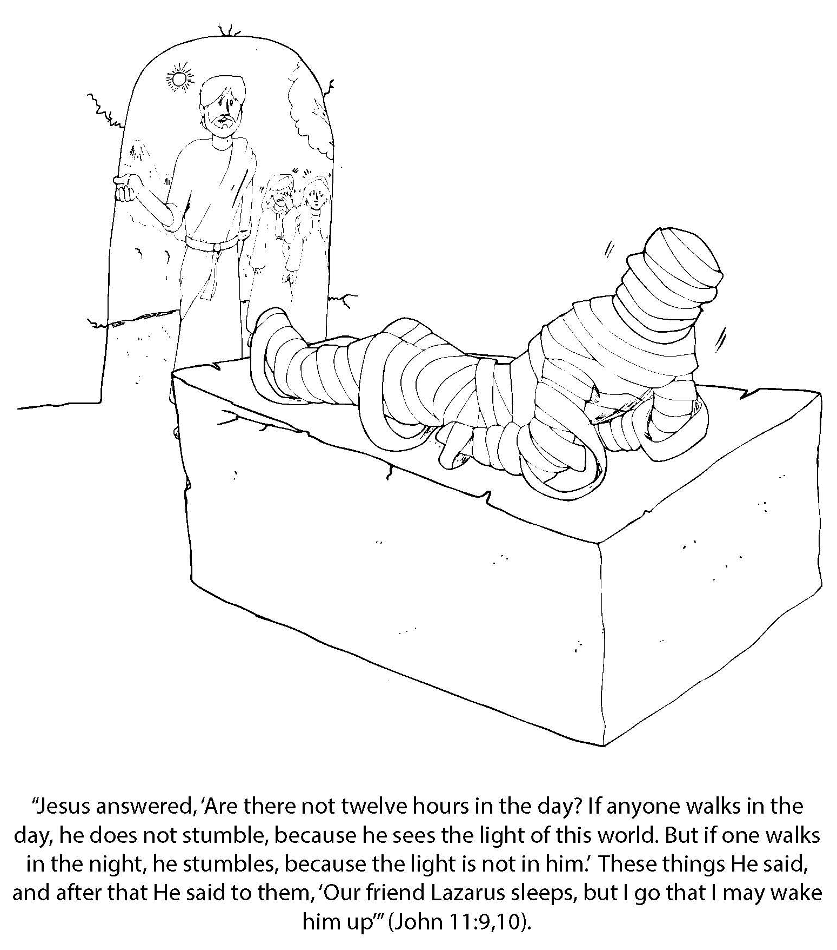
Booneville Church of Christ Kindergarten Bible Class
Quarter 3, Lesson 6
Today’s Lesson | Jesus Raises Lazarus John 11
Bible Words We Learned | Resurrect – to come alive again
Questions for Review | How long had Lazarus been dead when Jesus arrived? Four days What did Jesus do when he went to the grave? He cried. What did Jesus do for Lazarus? He brought him back to life
Bible Skills to Practice | An adult should look up the book of John. Ask the student to find chapter 11. Remind them the chapters are the larger numbers.
Memory Work | Luke 19:10 – for the Son of Man has come to seek and to save that which was lost. 12 Apostles Books of the Bible
Next Week’s Lesson | Zacchaeus Luke 19

Slide 7
Booneville Church of Christ Kindergarten Bible Class
Quarter 3, Lesson 7
Today’s Lesson | Zacchaeus Luke 19
Questions for Review | What was Zacchaeus’s job? Collecting taxes Why were tax collectors disliked? They took more money than they were supposed to and kept it for themselves. What did Zacchaeus tell Jesus he was going to do? Give away half of what he had to the poor and 4 times as much as he had taken.
Bible Skills to Practice | An adult should look up the book of Luke. Ask the student to find chapter 19. Remind them the chapters are the larger numbers.
Memory Work | Luke 19:10 – for the Son of Man has come to seek and to save that which was lost. 12 Apostles Books of the Bible
Next Week’s Lesson | Mary Anoints Jesus/The Triumphal Entry John 12:1-15

Slide 8
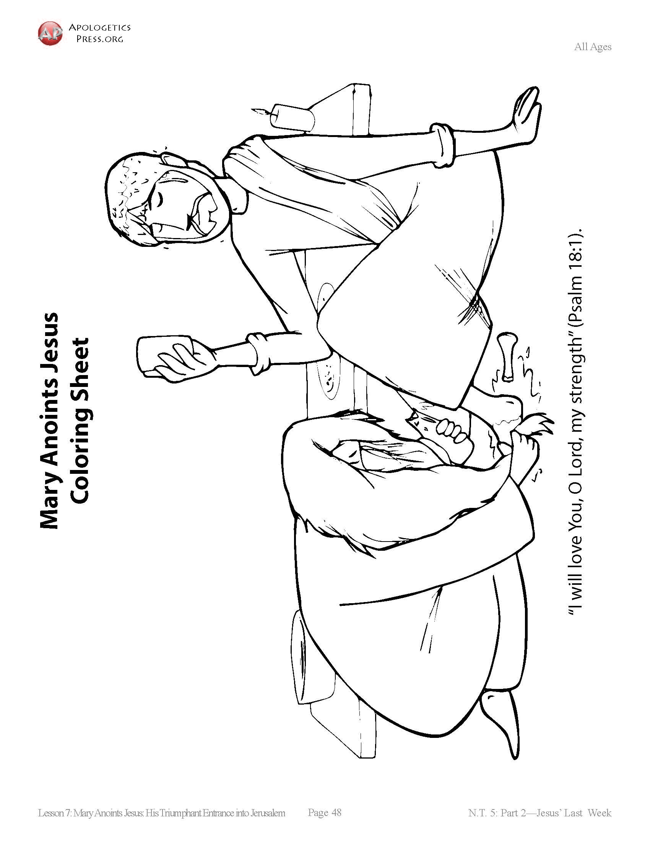
Booneville Church of Christ Kindergarten Bible Class
Quarter 3, Lesson 8
Today’s Lesson | Mary Anoints Jesus/The Triumphal Entry John 12:1-15
Bible Words We Learned | Hosanna – Save now
Questions for Review | What did Mary do to Jesus? Poured expensive perfume on his head and feet, then wiped it with her hair What did Jesus ride into Jerusalem? A donkey What did the people do when Jesus entered Jerusalem? They laid palm branches on the ground and praised him.
Bible Skills to Practice | An adult should look up the book of John. Ask the student to find chapter 12. Remind them the chapters are the larger numbers.
Memory Work | Luke 19:10 – for the Son of Man has come to seek and to save that which was lost. 12 Apostles Books of the Bible
Next Week’s Lesson | The Widow’s Mite/The Rich Young Ruler Mark 12, Luke 21, Matthew 6

Slide 9
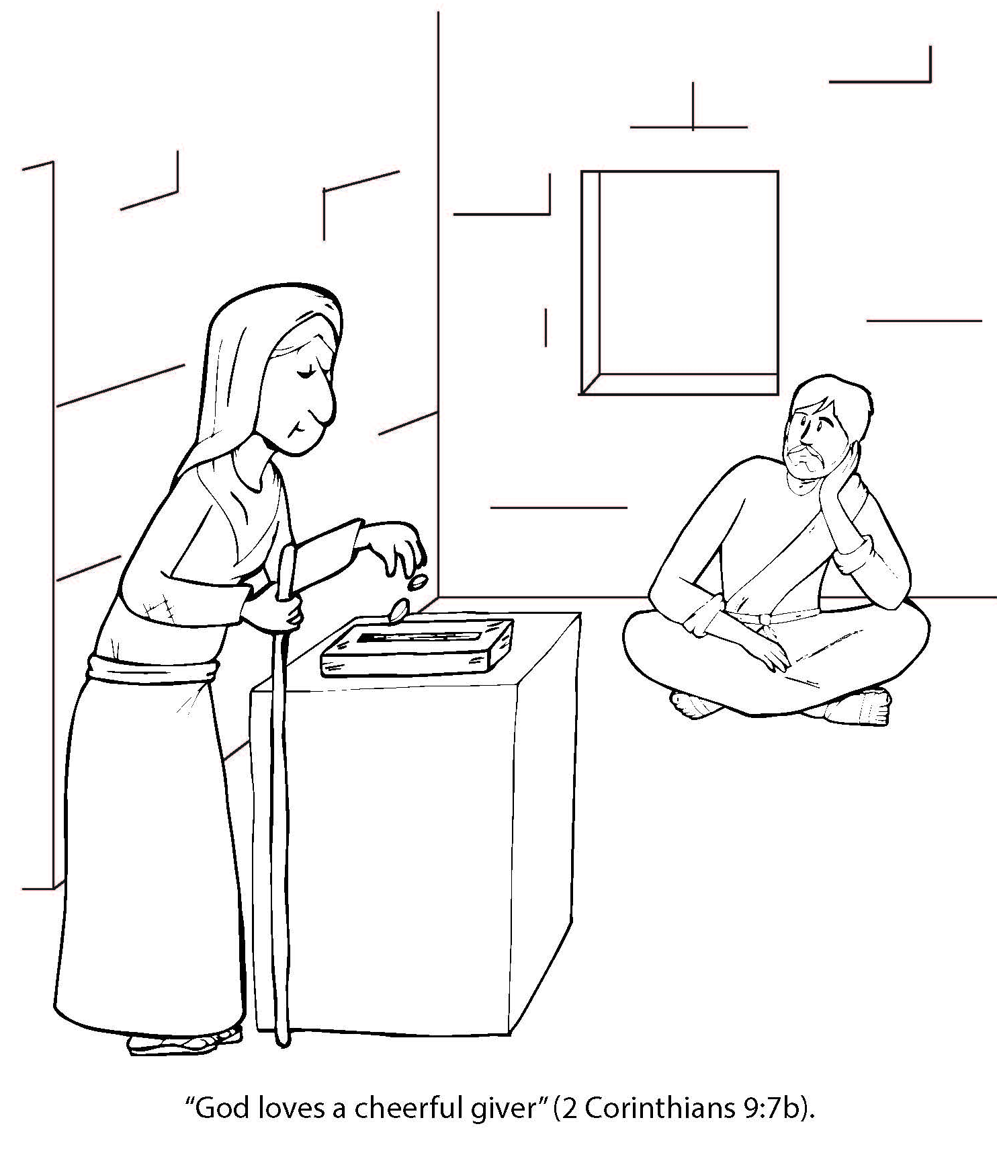
Booneville Church of Christ Kindergarten Bible Class
Quarter 3, Lesson 9
Today’s Lesson | The Widow’s Mite/The Rich Young Ruler Mark 12, Luke 21, Matthew 6
Questions for Review | How were the Jews putting their money into the offering? To be seen by men. How did the widow give in the right way? She gave all she had, making a real sacrifice. With what attitude are we to give? A cheerful heart and not grudgingly.
Bible Skills to Practice | An adult should look up the book of Luke. Ask the student to find chapter 21. Remind them the chapters are the larger numbers.
Memory Work | Luke 19:10 – for the Son of Man has come to seek and to save that which was lost. 12 Apostles Books of the Bible
Next Week’s Lesson | The Last Supper Matt. 26; Mark 14; Luke 22

Slide 10
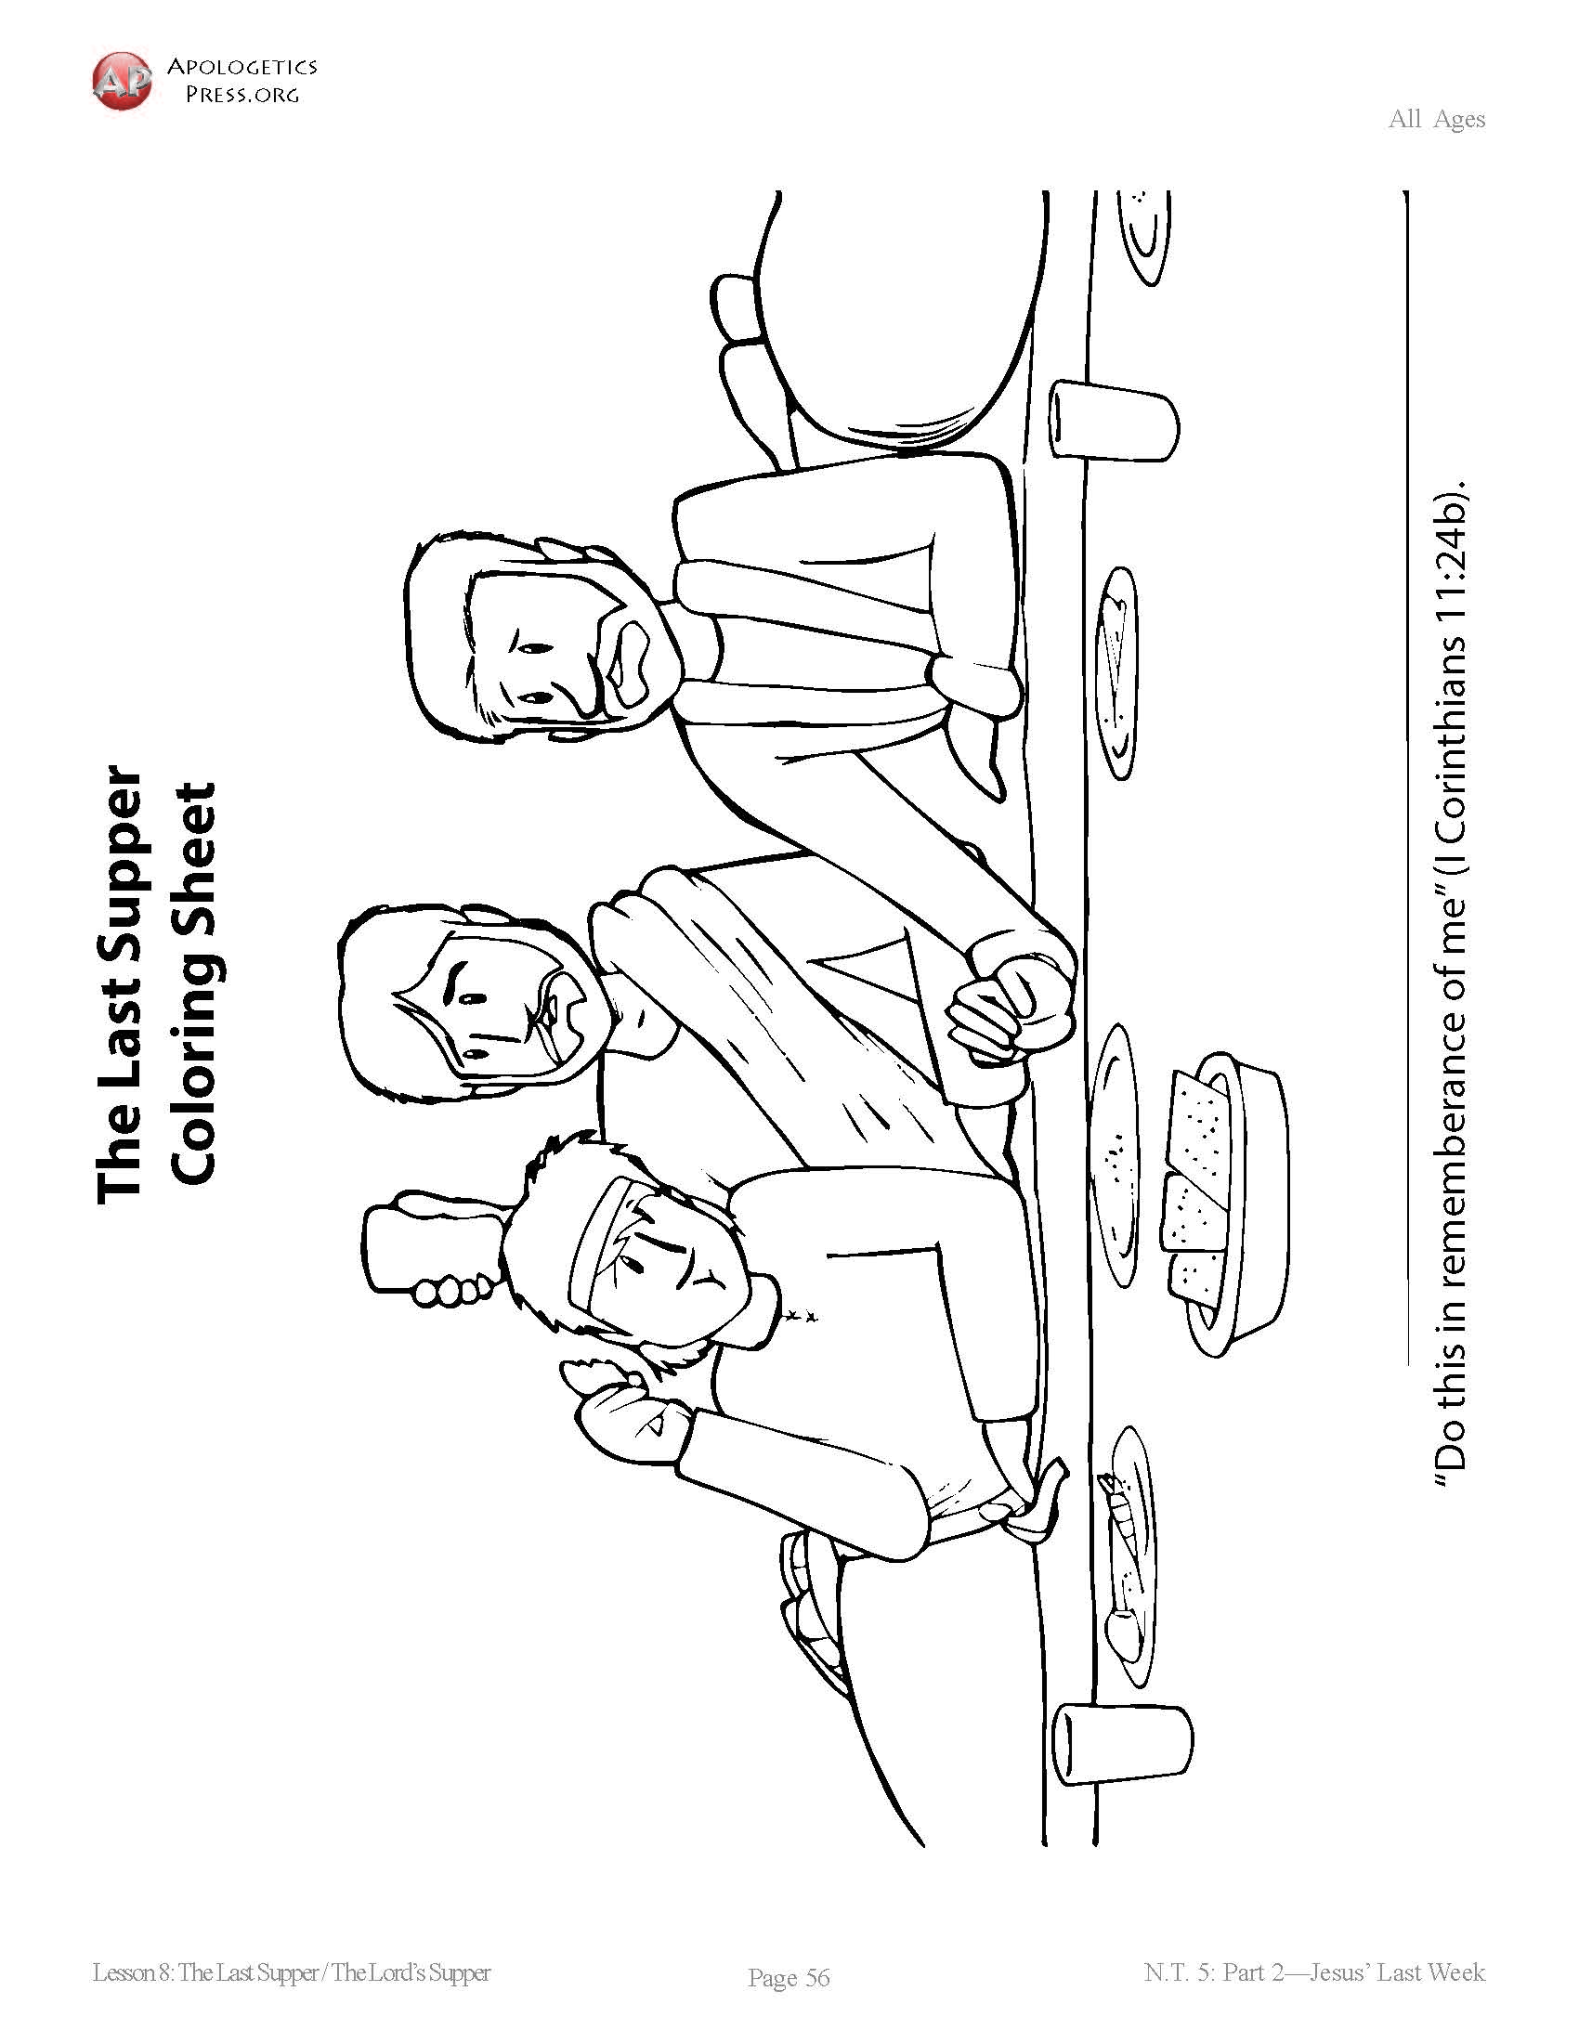
Booneville Church of Christ Kindergarten Bible Class
Quarter 3, Lesson 10
Today’s Lesson | The Last Supper Matt. 26; Mark 14; Luke 22
Questions for Review | What did Jesus do for the disciples ? He washed their feet What were tow things that were part of the Passover meal that Jesus used to teach a special lesson? The unleavened bread and the fruit of the vine. What does the bread represent? Jesus‘s body What does the fruit of the vine represent? Jesus’s blood
Bible Skills to Practice | An adult should assist the student in locating the books of Matthew, then Mark, and then Luke.
Memory Work | Luke 19:10 – for the Son of Man has come to seek and to save that which was lost. 12 Apostles Books of the Bible
Next Week’s Lesson | Jesus Prays Matt. 26, Mark 14; Luke 22; John 17

Slide 11
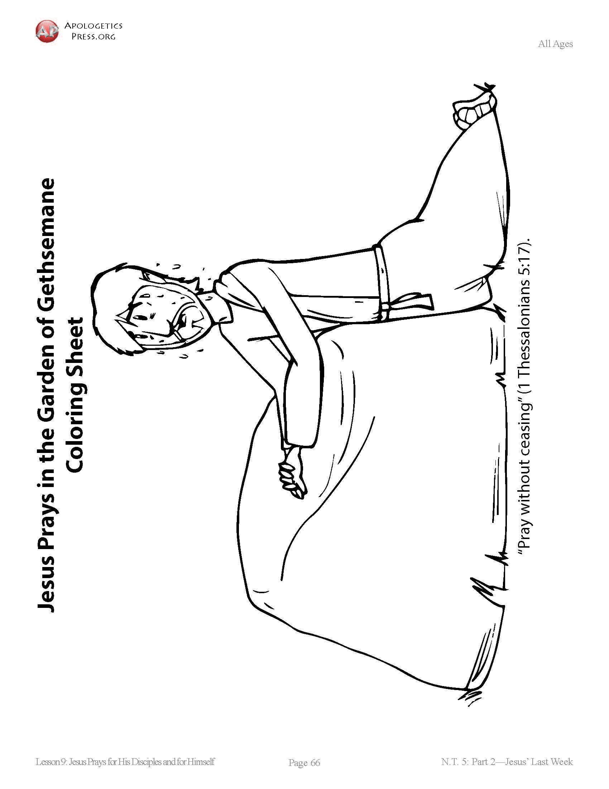
Booneville Church of Christ Kindergarten Bible Class
Quarter 3, Lesson 11
Today’s Lesson | Jesus Prays Matt. 26, Mark 14; Luke 22; John 17
Questions for Review | How many people were in the crowd? 5,000 men (not including women and children) What did Jesus use to feed the people? A boy’s lunch of 5 loaves of bread and 2 fish How was this enough to feed a crowd? Jesus made more food from the boy’s lunch
Bible Skills to Practice | An adult should assist the student in locating the books of Matthew, then Mark, Luke, and then John.
Memory Work | Luke 19:10 – for the Son of Man has come to seek and to save that which was lost. 12 Apostles Books of the Bible
Next Week’s Lesson | Jesus’s Trial and Crucifixion Matt. 26; Mark 14; Luke 22; John 18

Slide 12
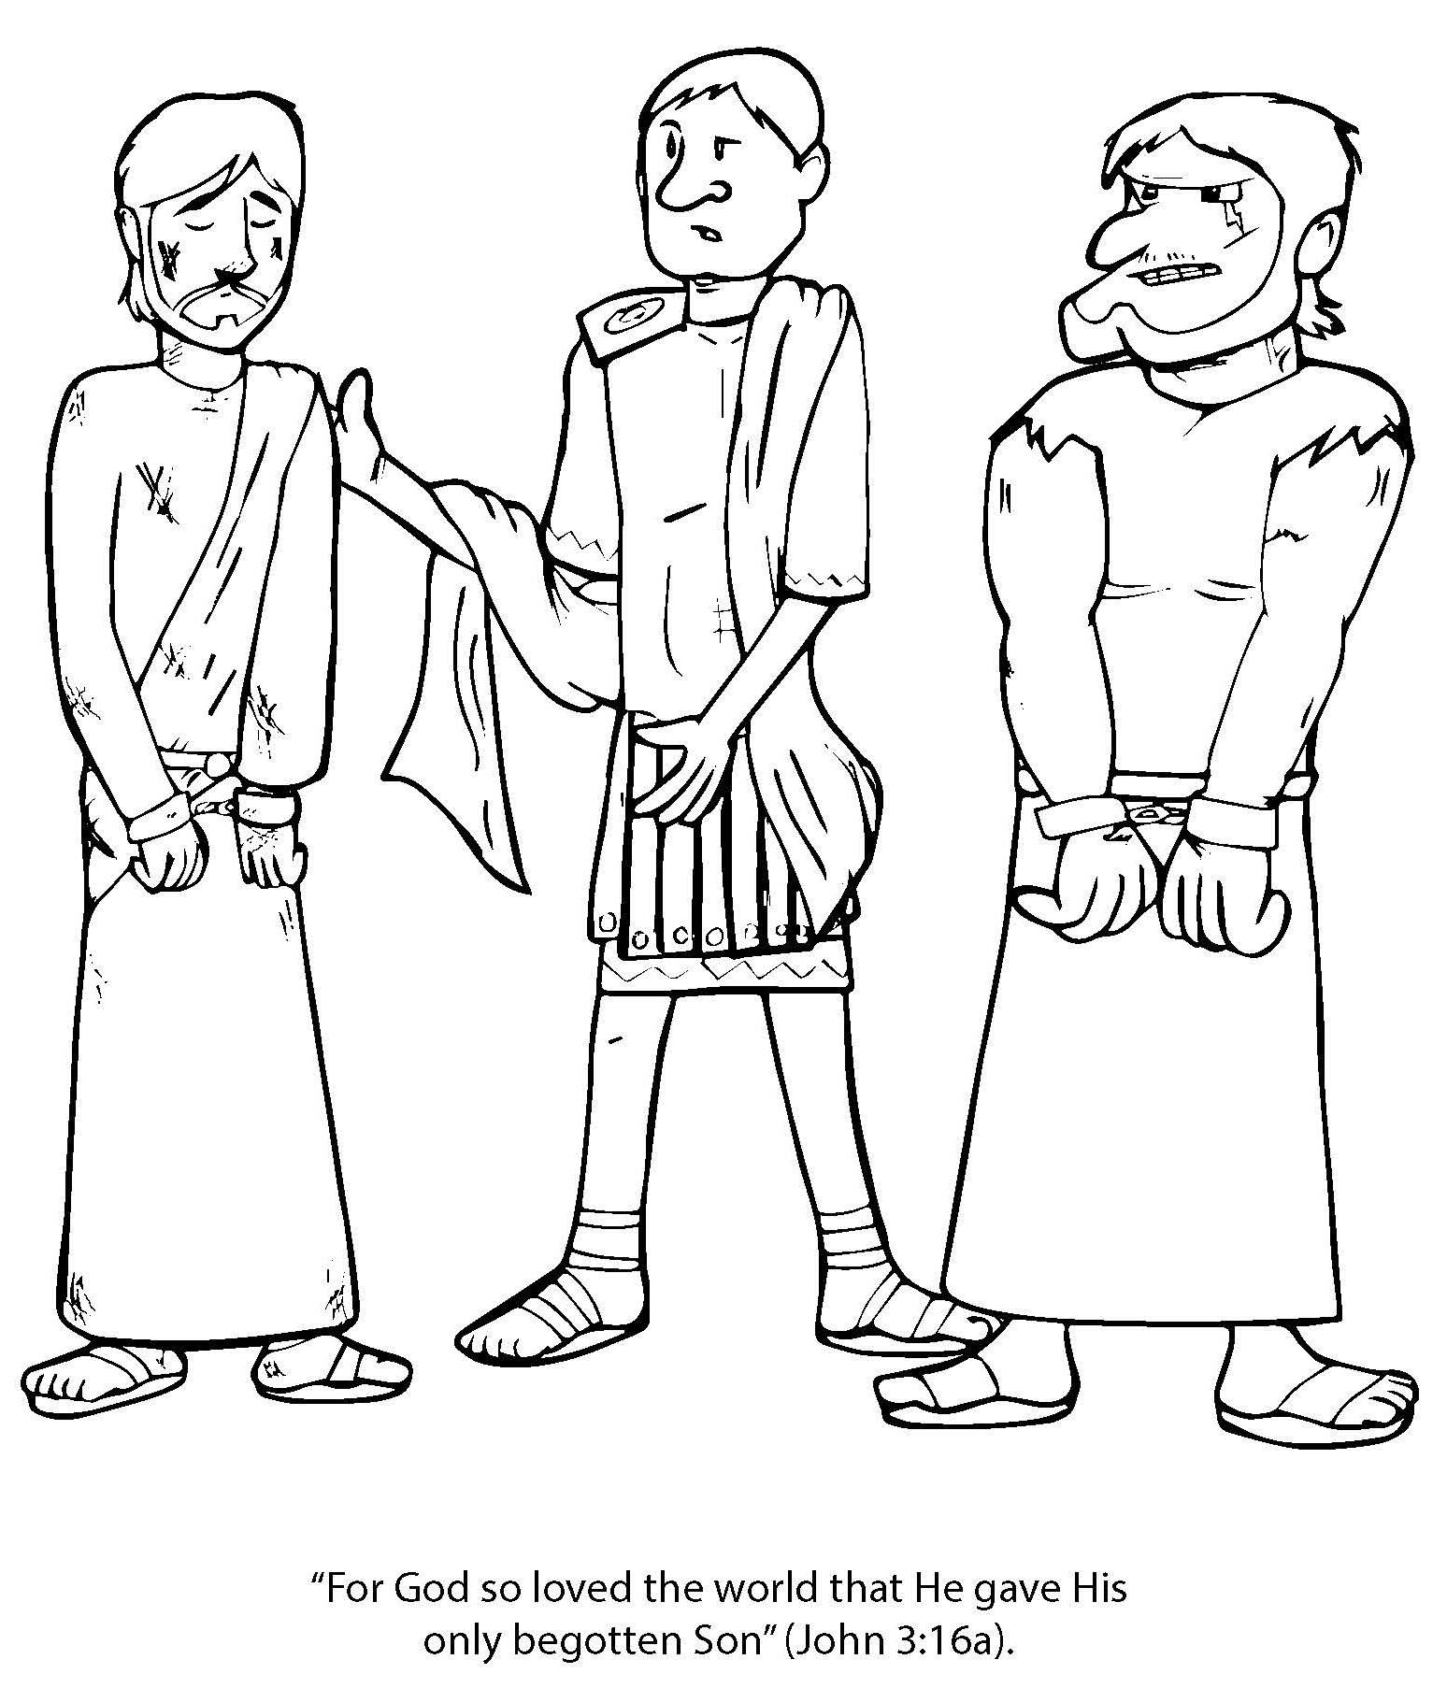
Booneville Church of Christ Kindergarten Bible Class
Quarter 3, Lesson 12
Today’s Lesson | Jesus’s Trial and Crucifixion Matt. 26; Mark 14; Luke 22; John 18
Questions for Review | Who betrayed Jesus with a kiss? Judas What happened to the disciples when Jesus was arrested? They left him. Who was the Roman governor that condemned Jesus to death? Pilate Who is our perfect sacrifice for sins? Jesus
Bible Skills to Practice | An adult should assist the student in locating the books of Matthew, then Mark, Luke, and then John.
Memory Work | Luke 19:10 – for the Son of Man has come to seek and to save that which was lost. 12 Apostles Books of the Bible
Next Week’s Lesson | Jesus’s Resurrection/ Appearances to the Apostles

Slide 13
Booneville Church of Christ Kindergarten Bible Class
Quarter 3, Lesson 13
Today’s Lesson | Jesus’s Resurrection/ Appearances to the Apostles Matt. 27; Mark 15; Luke 23-24; John 18
Questions for Review | On what day did Jesus rise from the dead? Sunday What does Jesus’s resurrection mean for Christians? We can go to Heaven one day
Bible Skills to Practice | An adult should assist the student in locating the books of Matthew, then Mark, Luke, and then John.
Memory Work | Luke 19:10 – for the Son of Man has come to seek and to save that which was lost. 12 Apostles Books of the Bible
Next Week’s Lesson | The Great Commission/ Jesus Ascends The end of the gospels/ Acts 1

