Slide 1
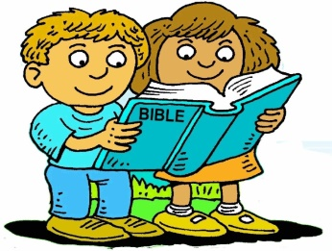
Booneville Church of Christ 4 Year Old Bible Class
Quarter 1, Lesson 1
Today’s Lesson | Creation, Days 1-4 Genesis 1
Bible Words We Learned | Genesis - beginning
Questions for Review | What did God do on Day 1? Made Light, Day and Night What did God do on Day 2? Separated the waters What did God do on Day 3? Made Land and plants What did God do on Day 4? Made the sun, moon, and stars
Memory Work | Genesis 1:1 Days of Creation
Next Week’s Lesson | Creation, Days 5-7 Genesis 1 and 2

Slide 2
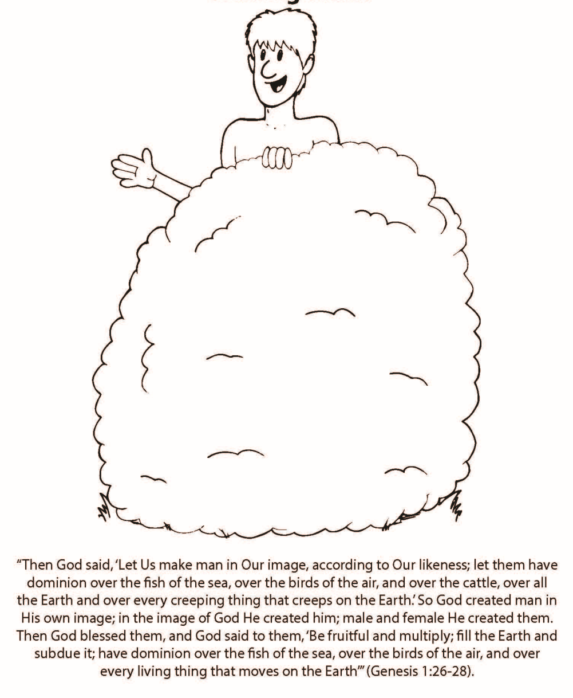
Booneville Church of Christ 4 Year Old Bible Class
Quarter 1, Lesson 2
Today’s Lesson | Creation, Days 5-7 Genesis 1 and 2
Bible Words We Learned | Genesis - beginning
Questions for Review | What did God make on Day 5? Birds and water animals What did God make on Day 6? Land animals and people Who was the first man and woman? Adam and Eve What did God do on Day 7? He rested
Memory Work | Genesis 1:1 Days of Creation
Next Week’s Lesson | The First Sin Genesis 2 and 3

Slide 3
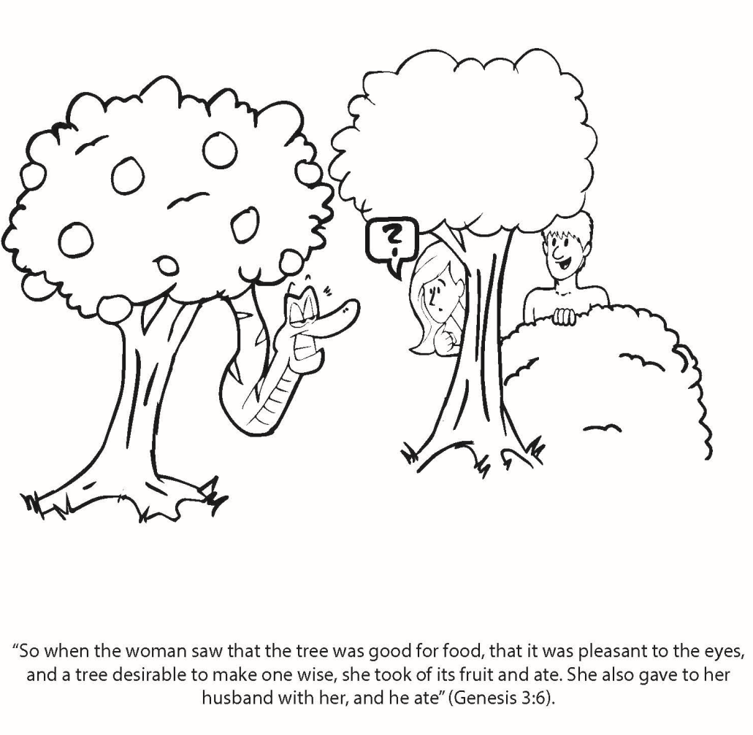
Booneville Church of Christ 4 Year Old Bible Class
Quarter 1, Lesson 3
Today’s Lesson | The First Sin Genesis 2and 3
Bible Words We Learned | Sin – to disobey God
Questions for Review | Where did Adam and Eve live? The Garden of Eden From which tree were they not supposed to eat? The tree of the knowledge of good and evil What happened to Adam and Eve after they disobeyed? They realized they were naked and had to wear clothes. They had to leave the Garden. It was harder to grow food. They would eventually die.
Memory Work | Genesis 1:1 Days of Creation
Next Week’s Lesson | The First Family/The First Murder Genesis 2-4

Slide 4
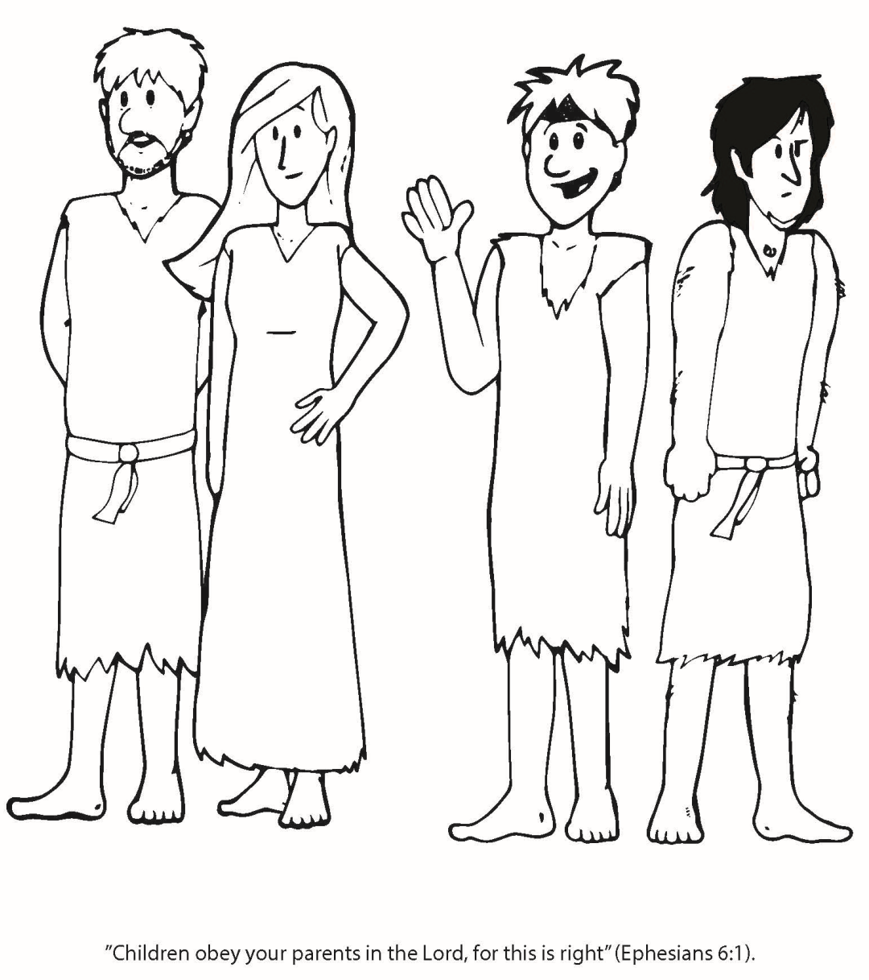
Booneville Church of Christ 4 Year Old Bible Class
Quarter 1, Lesson 4
Today’s Lesson | The First Family/The First Murder Genesis 2-4
Bible Words We Learned | Altar - a place where sacrifices are offered. This would often be built from stones.
Questions for Review | What are the names of the people in the first family? Adam (Dad), Eve (Mom), Cain, Abel, and Seth (sons). Were there more people in the first family? Yes, but the Bible doesn’t tell us their names. What did Cain do to Abel? He killed himl Why did Cain kill Abel? He was upset that God was pleased with Abel’s sacrifice but not his own.
Memory Work | Genesis 1:1 Days of Creation
Next Week’s Lesson | First Ship Builder Genesis 6-10

Slide 5
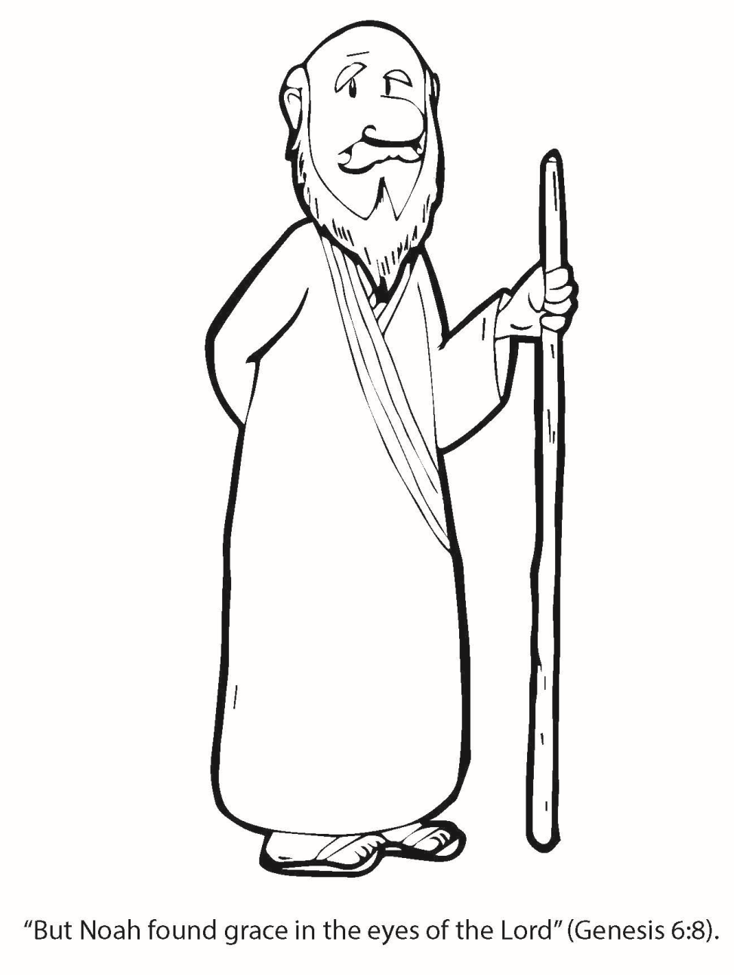
Booneville Church of Christ 4 Year Old Bible Class
Quarter 1, Lesson 5
Today’s Lesson | The First Shipbuilder Genesis 6-10
Bible Words We Learned | Pair – a set of two similar things
Questions for Review | Who built the ark? Noah How long did it rain? 40 days and nights How many people were saved on the ark? Eight – Noah, his wife, his 3 sons, and their wives What is the rainbow a sign of? God’s promise to not destroy the earth with water again
Memory Work | Genesis 1:1 Days of Creation
Next Week’s Lesson | The First Skyscraper Genesis 11:1-9

Slide 6
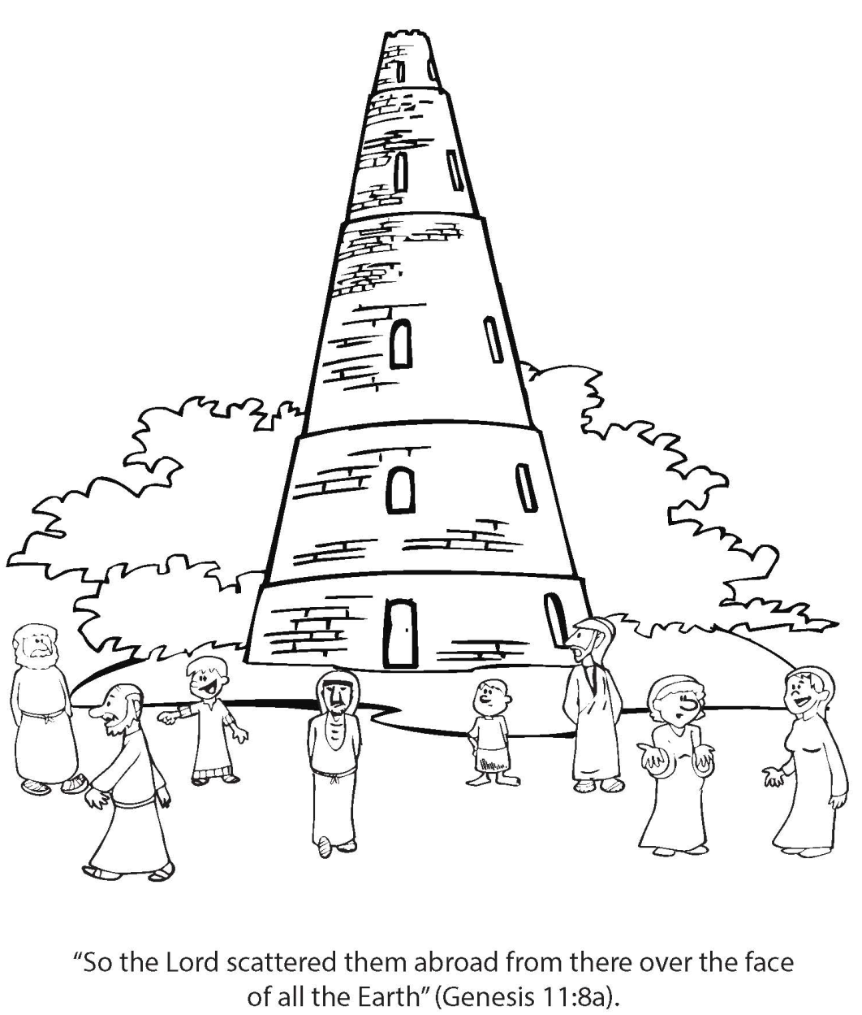
Booneville Church of Christ 4 Year Old Bible Class
Quarter 1, Lesson 6
Today’s Lesson | The First Skyscraper Genesis 11:1-9
Bible Words We Learned | Languages – words used to communicate
Questions for Review | What instruction of God’s were the builders not obeying? They did not scatter across the Earth. How did God stop them from working together? He confused their languages so that they couldn’t understand each other.
Memory Work | Genesis 1:1 Days of Creation
Next Week’s Lesson | God Calls Abram/God’s Promise to Abram Genesis 12

Slide 7
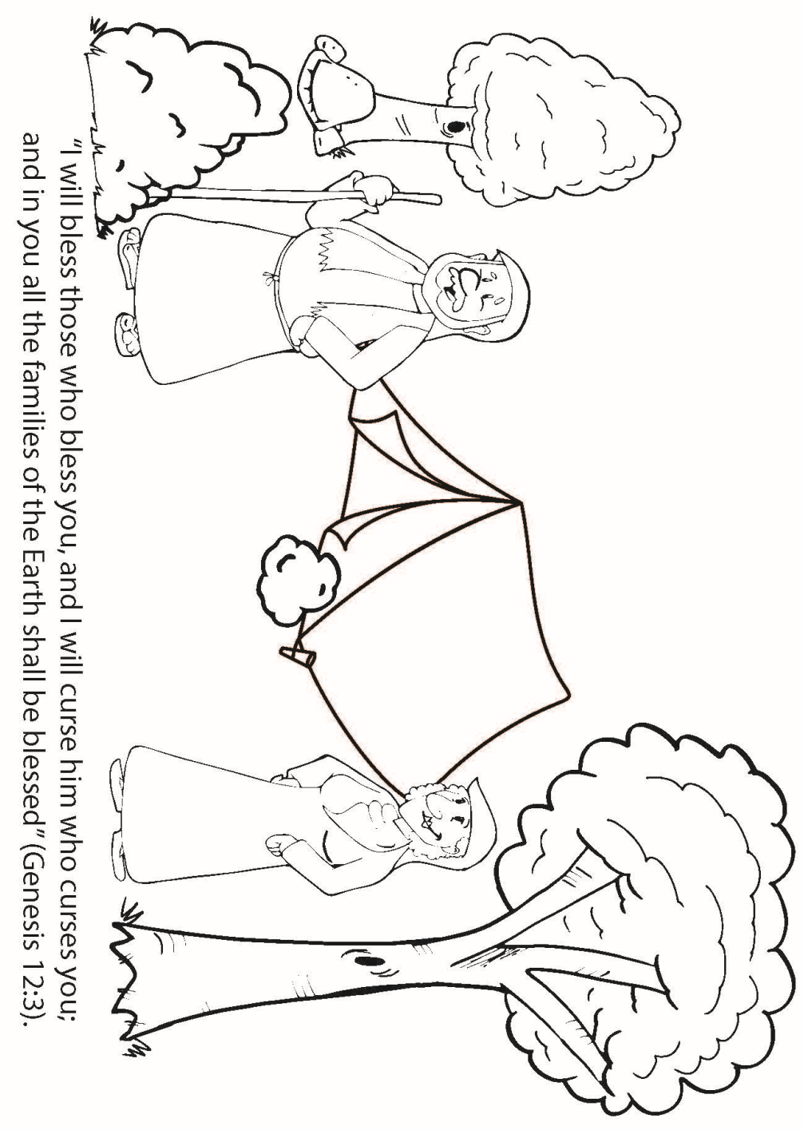
Booneville Church of Christ 4 Year Old Bible Class
Quarter 1, Lesson 7
Today’s Lesson | God Calls Abram/ God’s Promise to Abram Genesis 12
Bible Words We Learned | Descendant – an offspring such as children, grandchildren, great-grandchildren, etc.
Questions for Review | What were the 3 main promises God gave to Abram? He would give him many descendants He would give him and his descendants a special land – Canaan He would bless the world through one of his descendants - Jesus
Memory Work | Genesis 1:1 Days of Creation
Next Week’s Lesson | Abram and Lot/ Sodom and Gomorrah Genesis 13

Slide 8
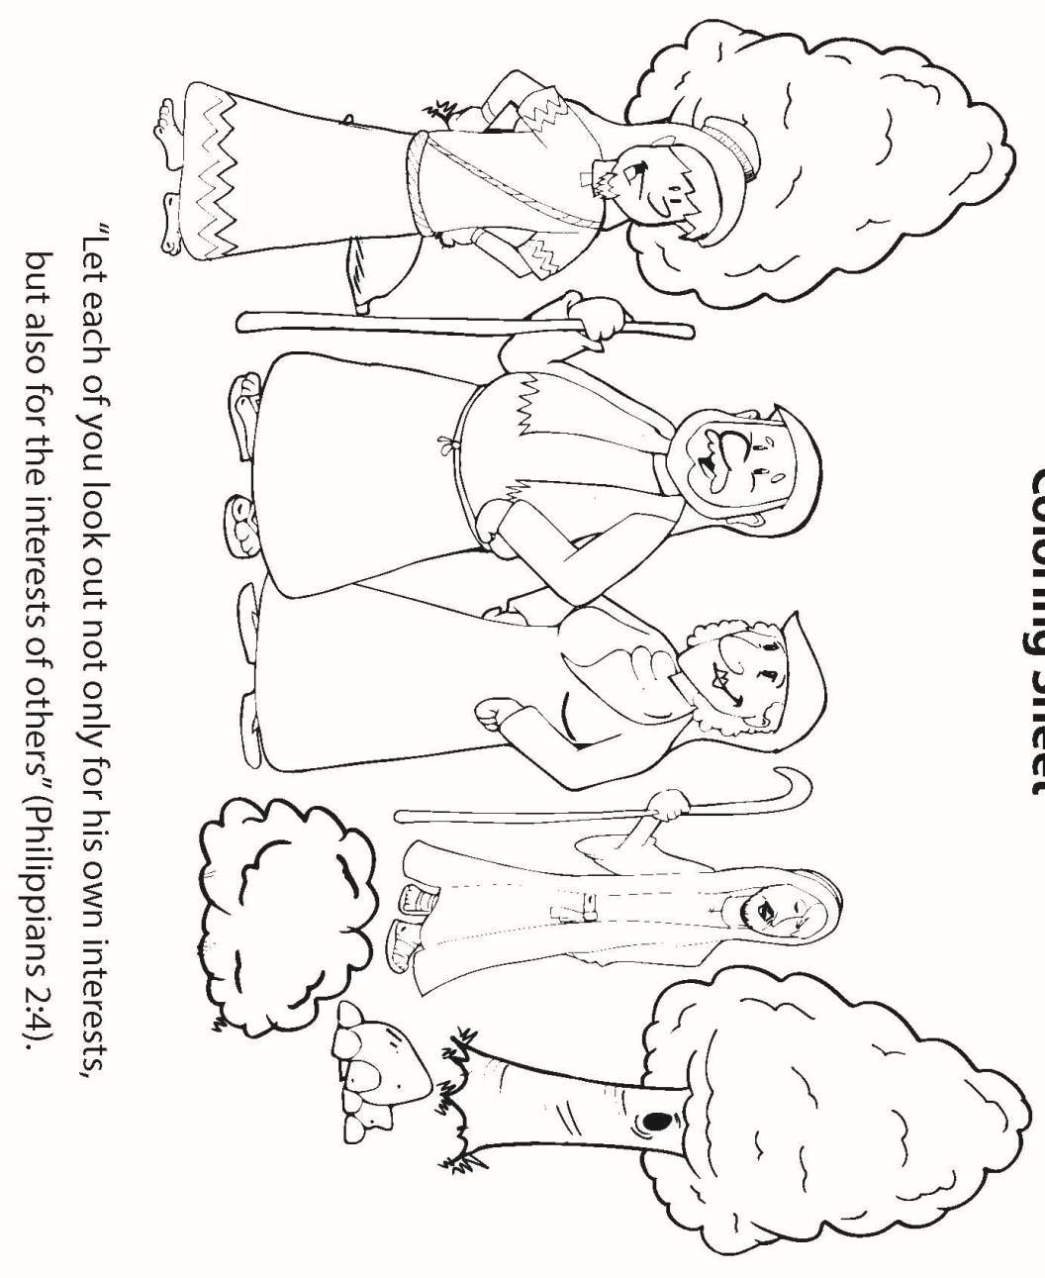
Booneville Church of Christ 4 Year Old Bible Class
Quarter 1, Lesson 8
Today’s Lesson | Abram and Lot/ Sodom and Gomorrah Genesis 13
Questions for Review | Why did Abram and Lot separate? Their servants were fighting over the land for the animals. Where did Lot move? Sodom What happened to Sodom? God destroyed it with fire from Heaven
Memory Work | Genesis 1:1 Days of Creation
Next Week’s Lesson | Promise of a Son/ A Son is Born Genesis 15-21

Slide 9
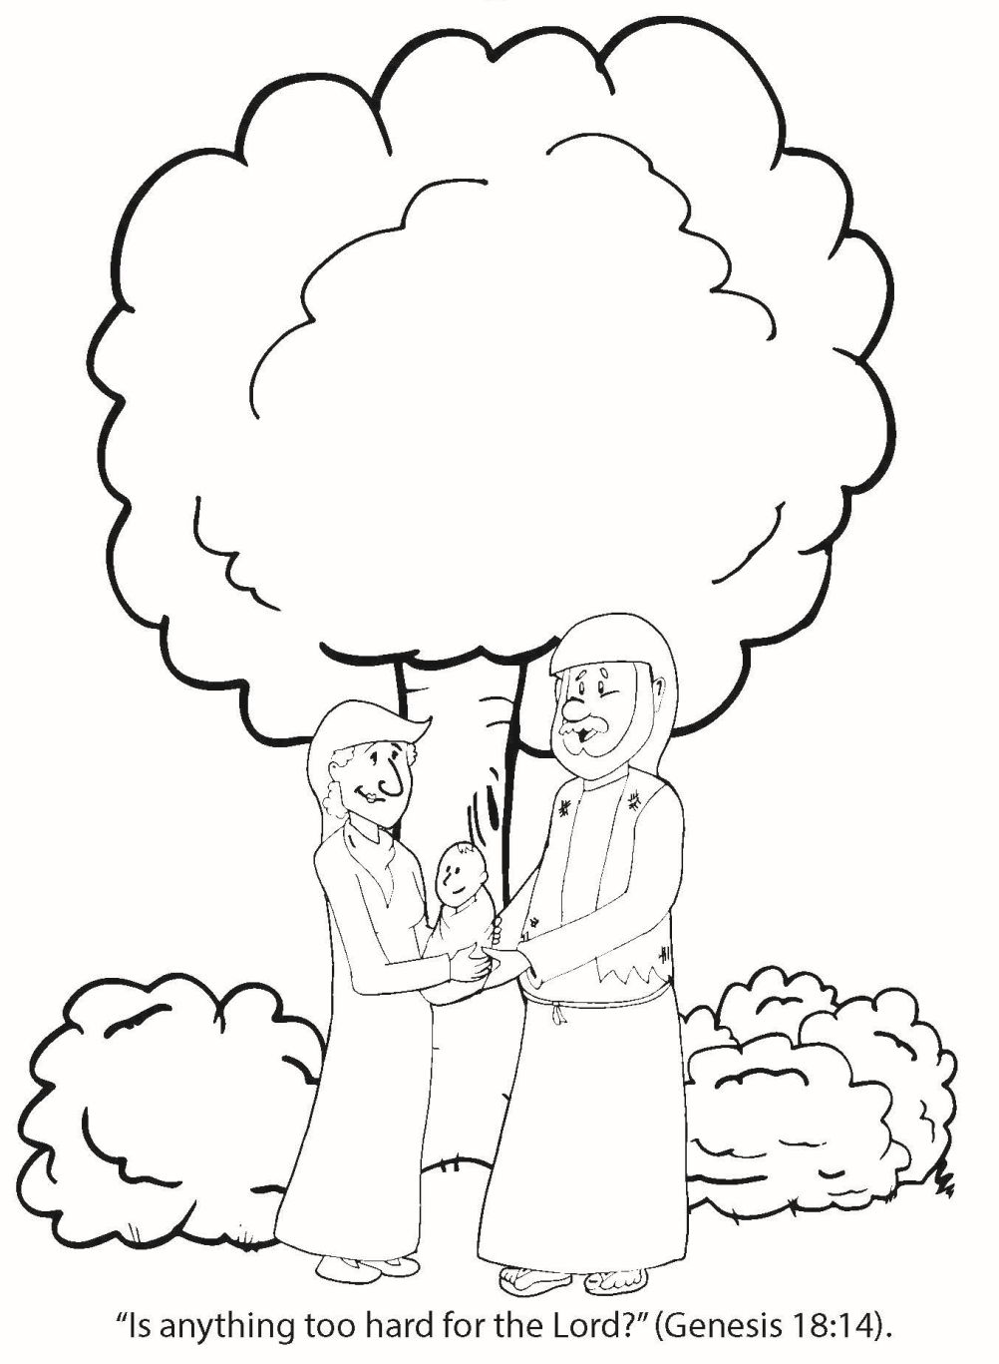
Booneville Church of Christ 4 Year Old Bible Class
Quarter 1, Lesson 9
Today’s Lesson | Promise of a Son/ A Son is Born Genesis 15-21
Questions for Review | What did Sarah do when she heard she would have a son? She laughed. What was the name of Abraham and Sarah’s son? Isaac What does Isaac mean? Laughter
Memory Work | Genesis 1:1 Days of Creation
Next Week’s Lesson | Abraham Offers Isaac Genesis 22

Slide 10
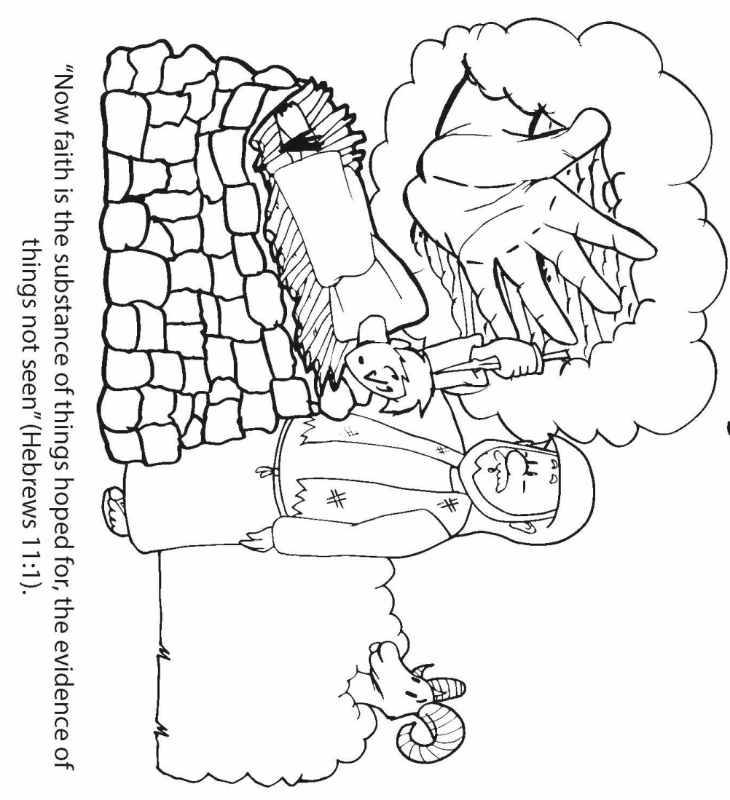
Booneville Church of Christ 4 Year Old Bible Class
Quarter 1, Lesson 10
Today’s Lesson | Abraham Offers Isaac Genesis 22
Bible Words We Learned | Faith – belief, trust, and loyalty to someone such as God
Questions for Review | What did God ask Abraham to do? Sacrifice his son, Isaac What happened when Abraham went to sacrifice his son? God stopped him. What did Abraham sacrifice instead? A ram
Memory Work | Genesis 1:1 Days of Creation
Next Week’s Lesson | The Search for Isaac’s Wife Genesis 24

Slide 11
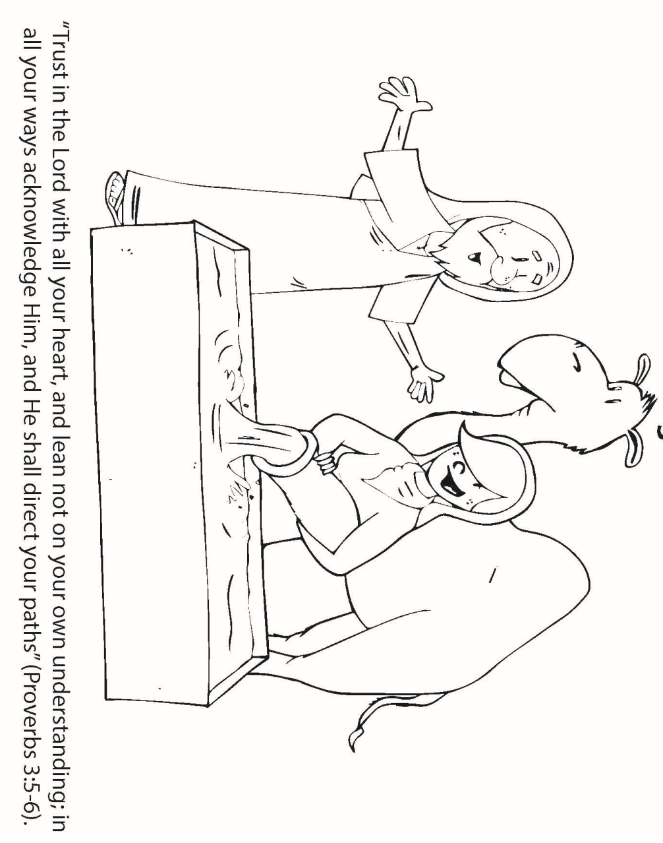
Booneville Church of Christ 4 Year Old Bible Class
Quarter 1, Lesson 11
Today’s Lesson | The Search for Isaac’s Wife Genesis 24
Questions for Review | What did Abraham send his servant to do? Find a wife for Isaac. Who did the servant ask for help? God What was Isaac’s wife’s name? Rebekah
Memory Work | Genesis 1:1 Days of Creation
Next Week’s Lesson | Sharing: Jacob and Esau Genesis 25

Slide 12
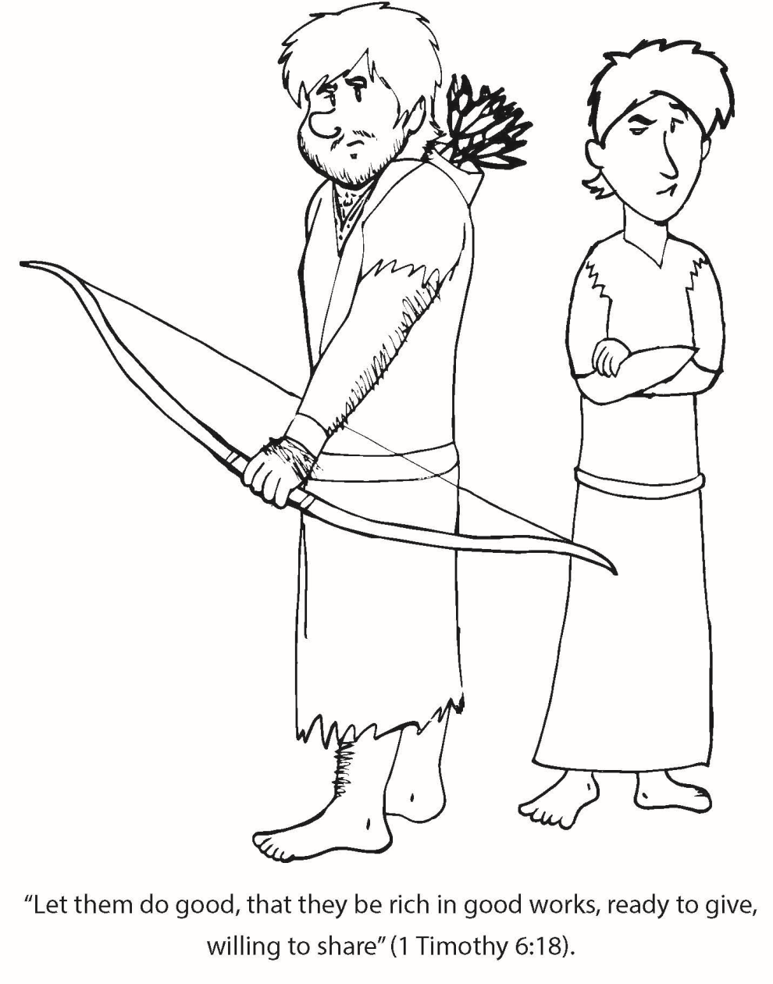
Booneville Church of Christ 4 Year Old Bible Class
Quarter 1, Lesson 12
Today’s Lesson | Sharing: Jacob and Esau Genesis 25
Bible Words We Learned | Birthright – special privileges given to the first born son. This included a double portion of the inheritance.
Questions for Review | Who were Isaac and Rebekah’s sons? Esau and Jacob. Who had hairy skin? Esau Who liked to cook? Jacob Which son traded his birthright? Why? Esau, because he was very hungry.
Memory Work | Genesis 1:1 Days of Creation
Next Week’s Lesson | Jacob Deceives His Father/ Jacob’s Dream Genesis 27:

Slide 13
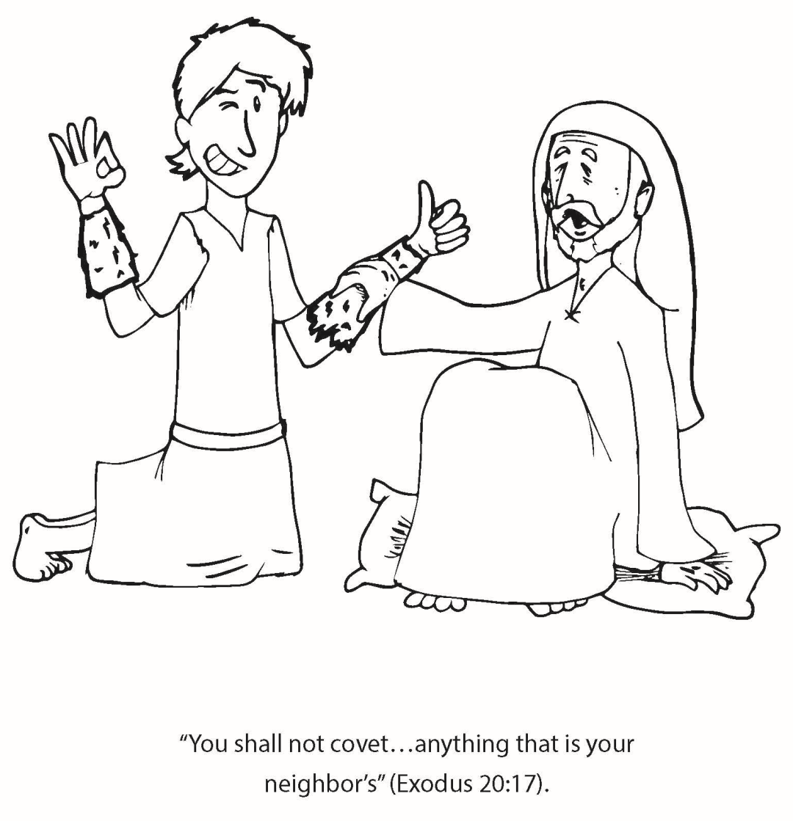
Booneville Church of Christ 4 Year Old Bible Class
Quarter 1, Lesson 13
Today’s Lesson | Jacob Deceives His Father/Jacob’s Dream Genesis 27-28
Bible Words We Learned | Deceive – to mislead or trick
Questions for Review | (1) Who was blind? Isaac (2) How did Jacob trick his father? He wore animal hair and Esau’s clothes to make his father think he was Esau. (3) What did Jacob do after Esau found out he stole the blessing? He ran away to his Uncle Laban’s.
Memory Work
Next Week’s Lesson | Marriages to Leah and Rachel Genesis 29

