Slide 1
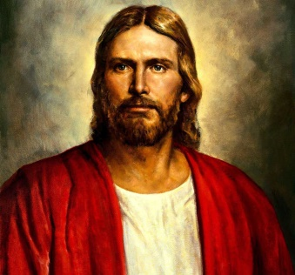
For God so
the that He gave His
only begotten Son,
that whoever believes in s
should not perish but
have everlasting life.
John 3:16
.
John 3:16
John 3:16 (NKJV) For God so loved the world that He gave His only begotten Son, that whoever believes in Him should not perish but have everlasting life.

